Slide 1
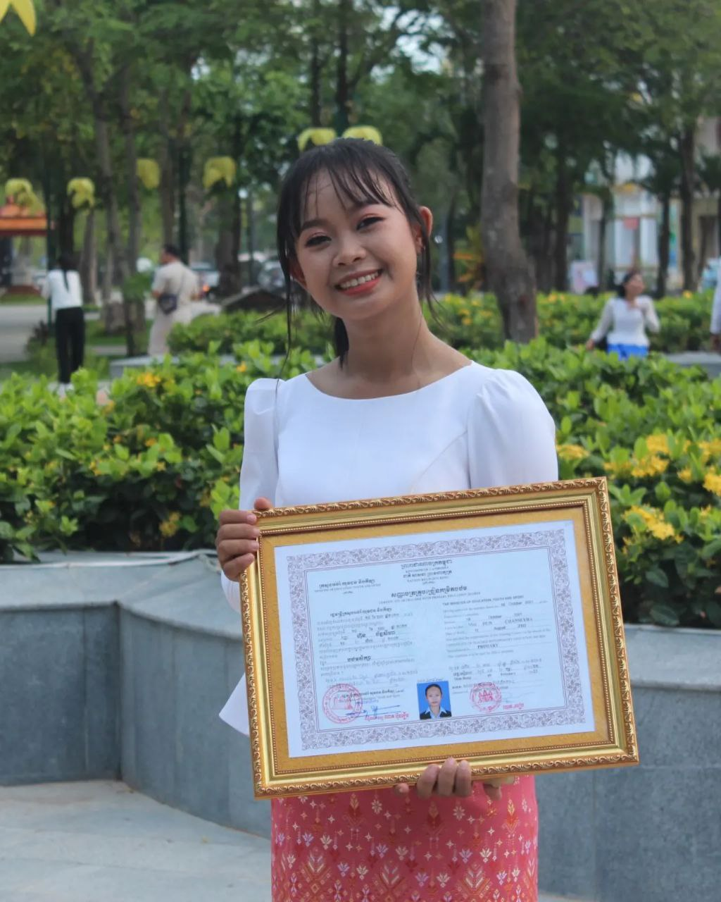
English grade 5
Chapter 3 School and Family
Unit 3 School
What do you have in your bag?
Student’s book 54

Slide 2
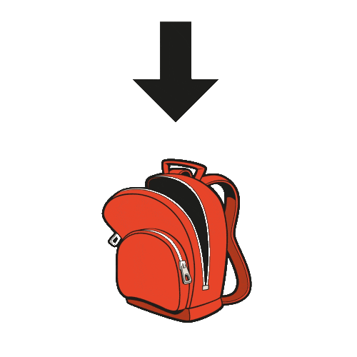
Bag
កាបូប

Slide 3
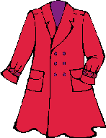
Coat
អាវក្រៅ/អាវធំ

Slide 4
Pen
ប៊ិក

Slide 5
Pencil
ខ្មៅដៃ

Slide 6
Listen and repeat
What do you have in your bag?
តើអ្នកមានអ្វីខ្លះក្នុងកាបូបអ្នក?

Slide 7
Listen and repeat
I have a blue pen in my bag.
ខ្ញុំមានប៊ិកខៀវមួយក្នុងកាបូបខ្ញុំ។

Slide 8
Pair work
What do you have in your bag?
I have a blue pen in my bag.
Blue, black, red, white,...
Pen, pencil, book, coat, ruler…..

Slide 9
Group work
Blue, black, red, white,... Pen, pencil, book, coat, ruler…..
1
What do you have in your bag?
I have a ….. …… in my bag.
What do you have in your bag?
4
I have a blue pen in my bag.
What do you have in your bag?
2
I have a ….. …… in my bag.
What do you have in your bag?
3

Slide 10
By Hun chanseyha

