Slide 1
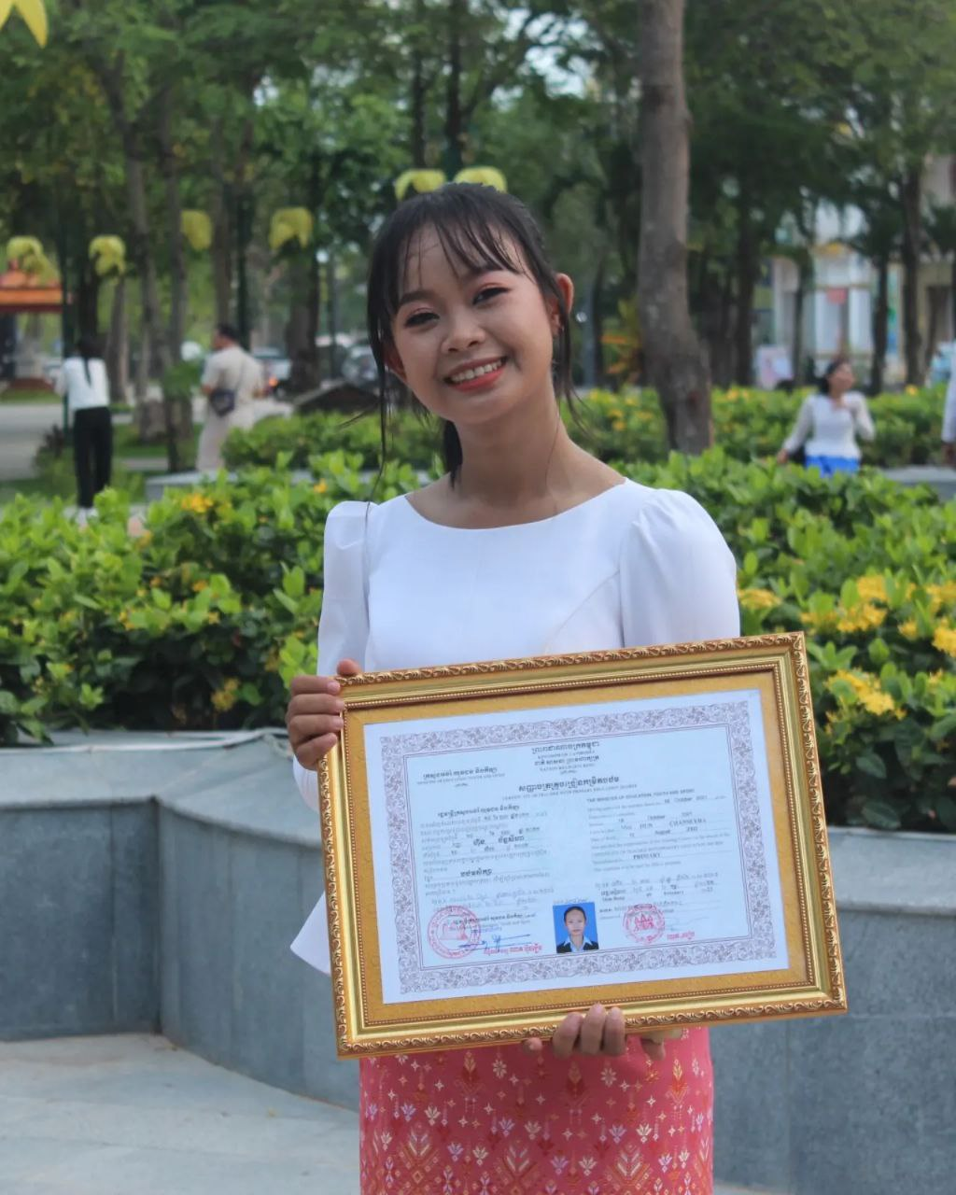
English grade 5
Chapter 3 School and Family
Unit 4 Family Holidays
Where are you going on a holiday?
Student’s book 58

Slide 2
Holiday
ថ្ងៃសម្រាក/ថ្ងៃបុណ្យ

Slide 3
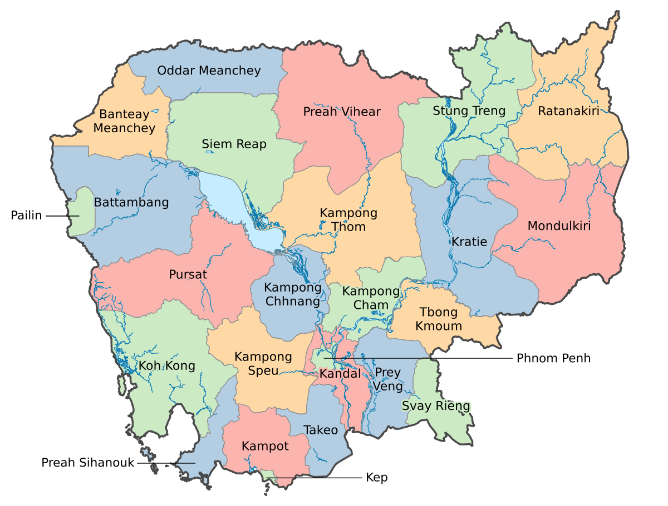
Province
ខេត្ត

Slide 4
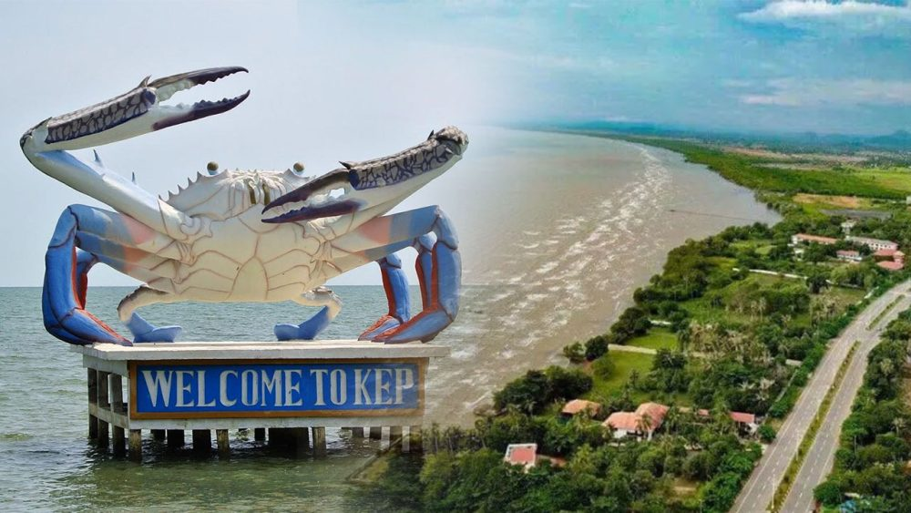
Kep province
ខេត្តកែប

Slide 5
Listen and repeat
Where are you going on a holiday?
តើអ្នកទៅណាខ្លះនៅថ្ងៃសម្រាក?

Slide 6
Listen and repeat
I’m going to Kep province.
ខ្ញុំនឹងទៅខេត្តកែប។

Slide 7
Pair work
Where are you going on a holiday?
I’m going to Kep Province.
Kep province, Siemreap, Battambong, Pailin, Koh Kong…..

Slide 8
Group work
Kep province, Siemreap, Battambong, Pailin, Koh Kong…..
1
Where are you going on a holiday?
I’m going to ……………….
Where are you going on a holiday?
4
I’m going to Kep Province.
Where are you going on a holiday?
2
I’m going to ………………...
Where are you going on a holiday?
3

Slide 9
By Hun chanseyha

