Slide 1

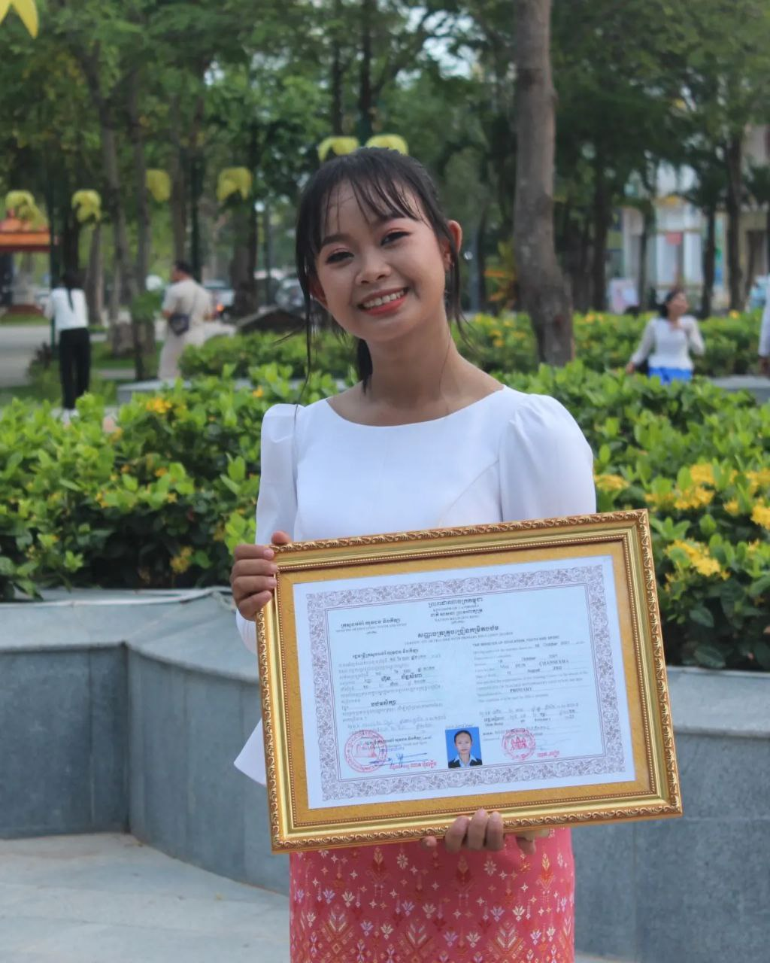
English grade 5
Chapter 3 School and Family
Unit 4 Family Holidays
What do you like to do?
Student’s book 58

Slide 2

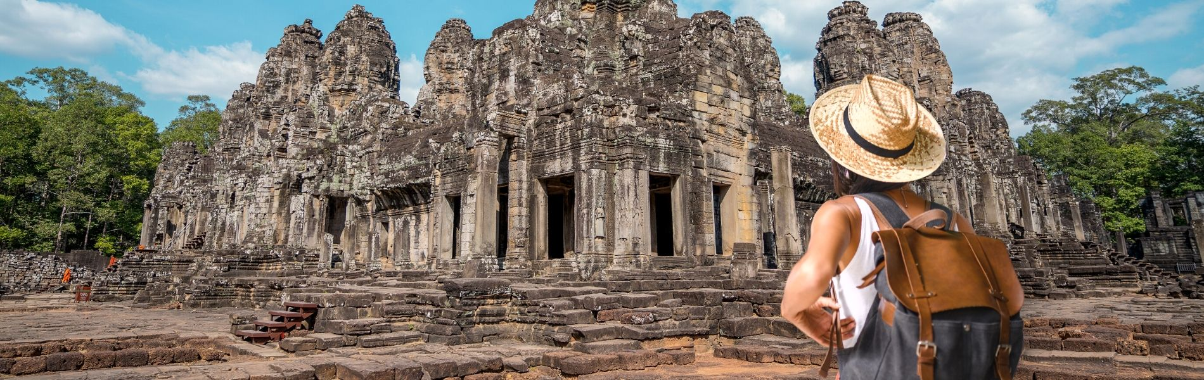
See the temple
ទស្សនាប្រាសាទ

Slide 3
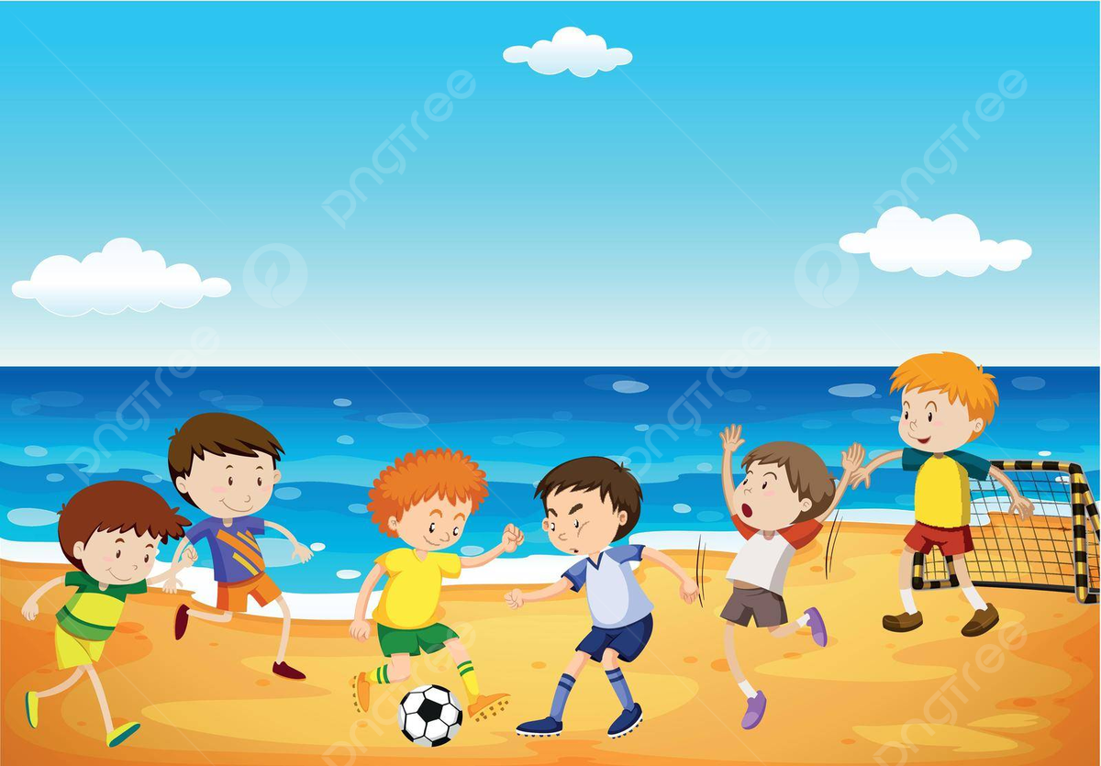
To play football
លេងបាល់ទាត់

Slide 4
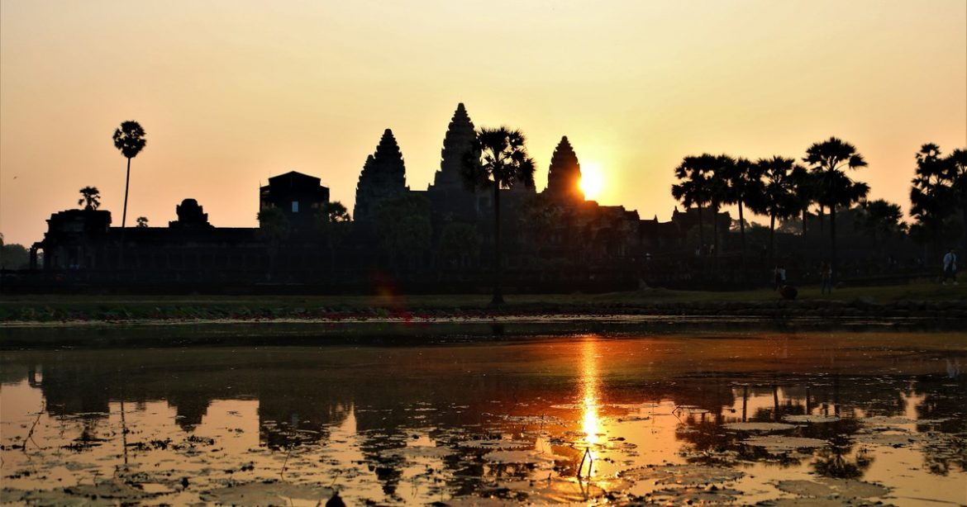
See the sunset
មើលថ្ងៃលិច

Slide 5
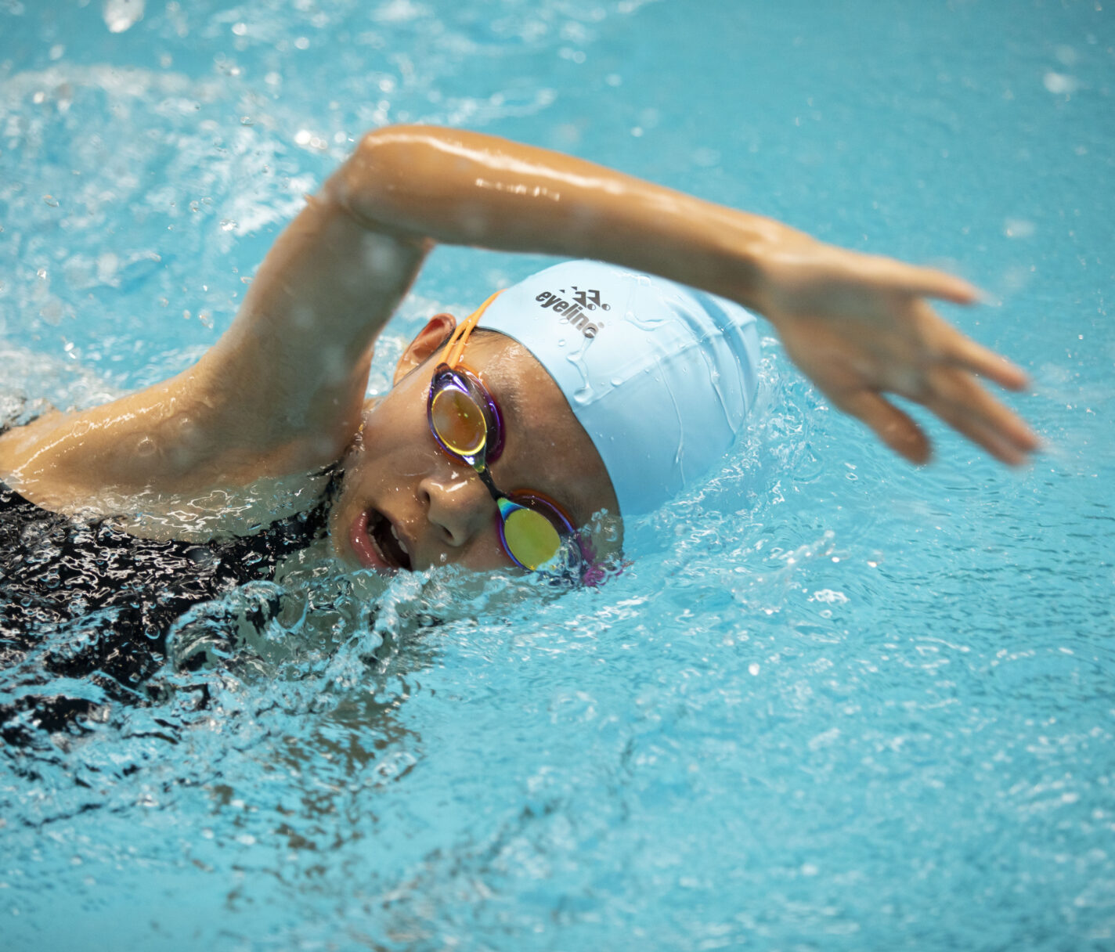
swim
ហែលទឹក

Slide 6
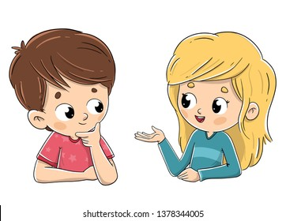
Listen and repeat
What do you like to do on holiday?
តើអ្នកចូលចិត្តធ្វើអ្វីនៅថ្ងៃសម្រាក?

Slide 7
Listen and repeat
I like to play football.
ខ្ញុំចូលចិត្តលេងបាល់។

Slide 8

Pair work
What do you like to do on holiday?
I like to play football.
Play football, to see the sunset, see the temple, swimming, going up the mountain……

Slide 9
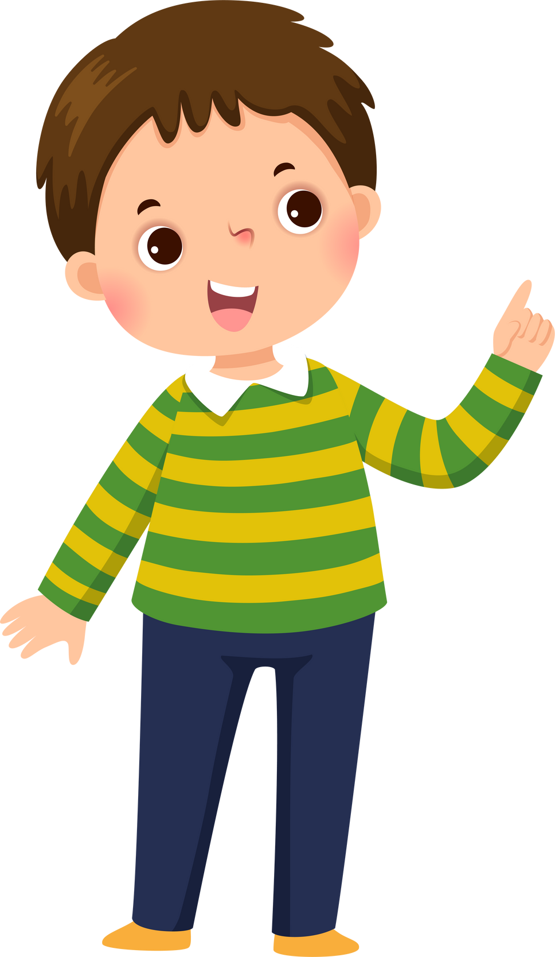

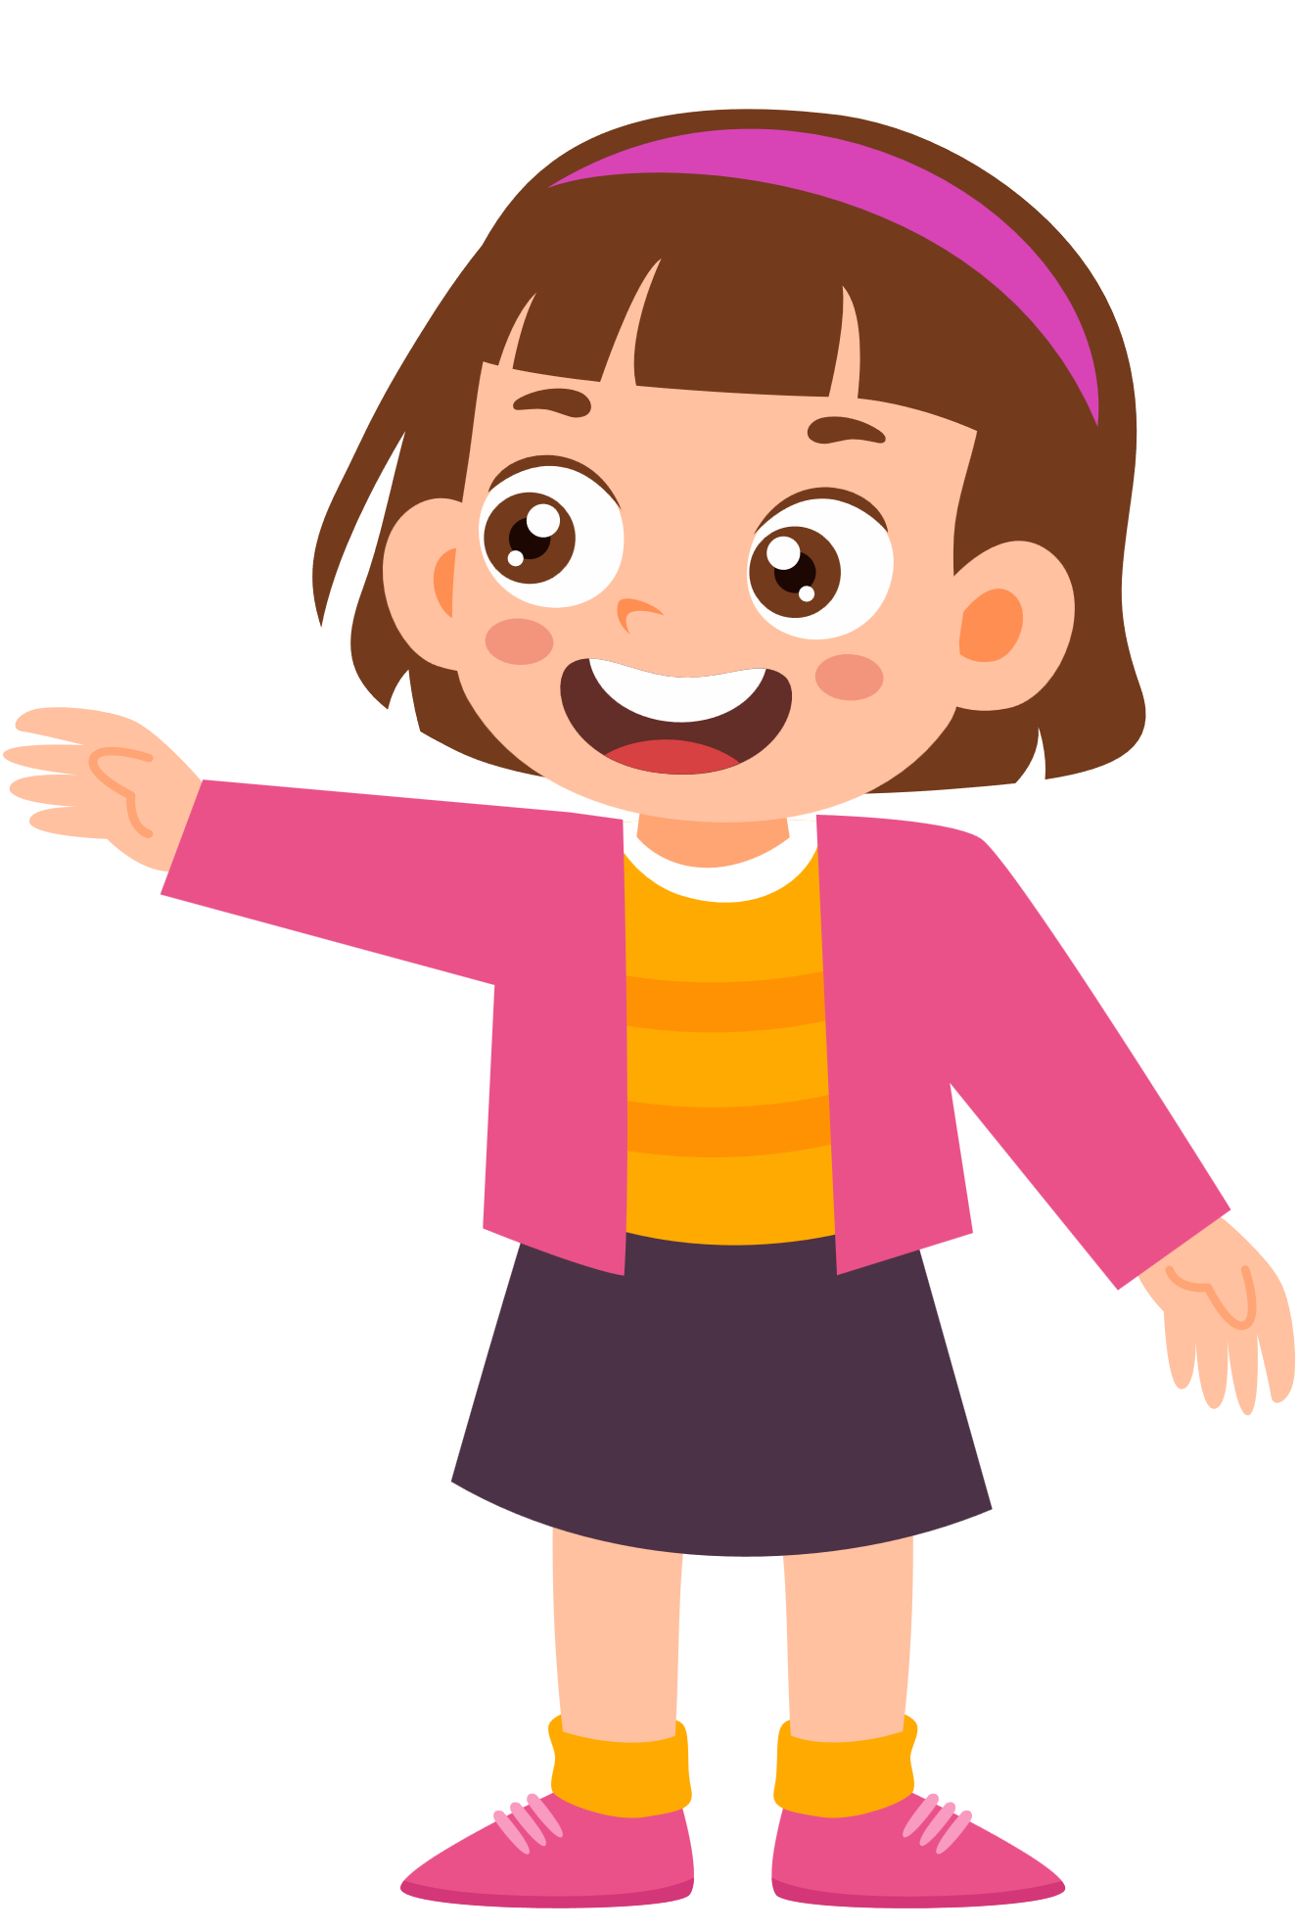
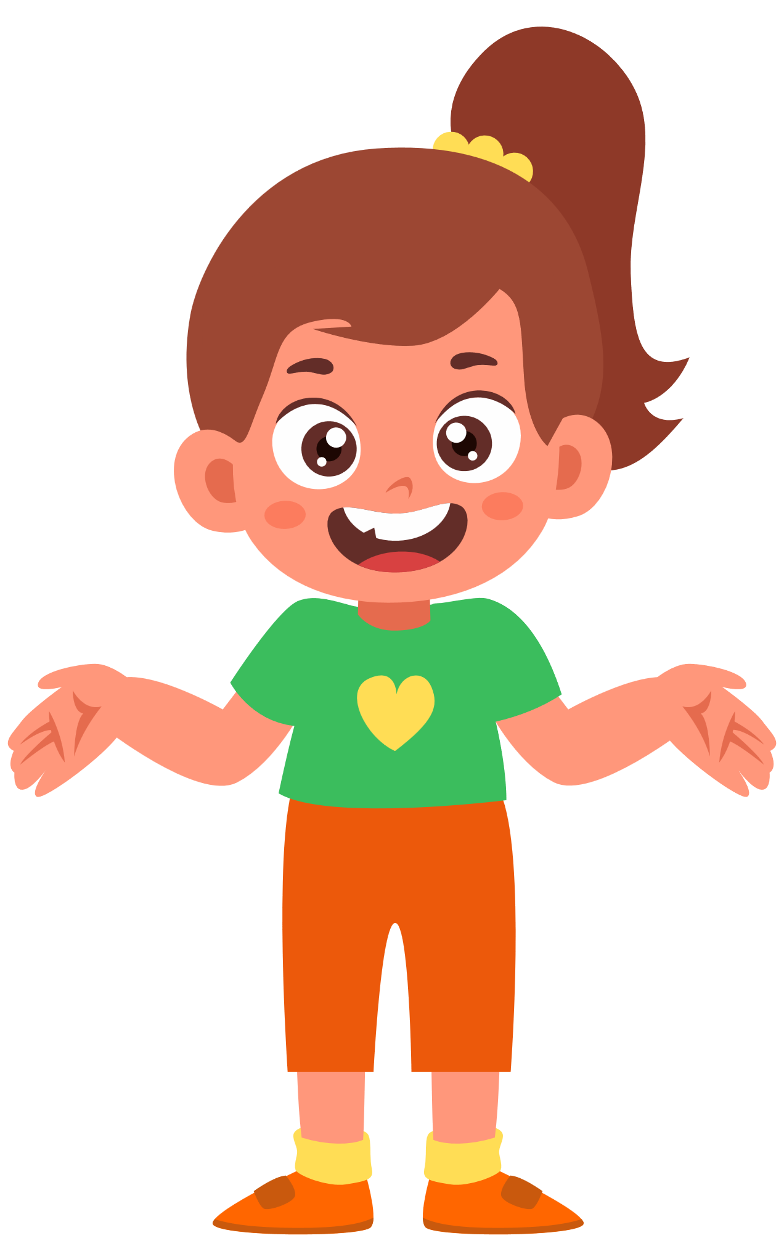
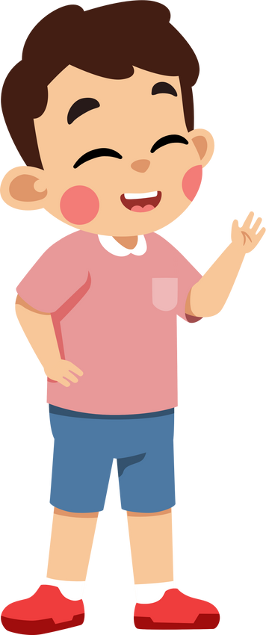
Group work
Play football, to see the sunset, see the temple, swimming, going up the mountain……
1
What do you like to do on holiday?
I like ……………….
What do you like to do on holiday?
4
I like to play football.
What do you like to do on holiday?
2
I like ……………….
What do you like to do on holiday?
3

Slide 10


By Hun chanseyha

