Slide 1
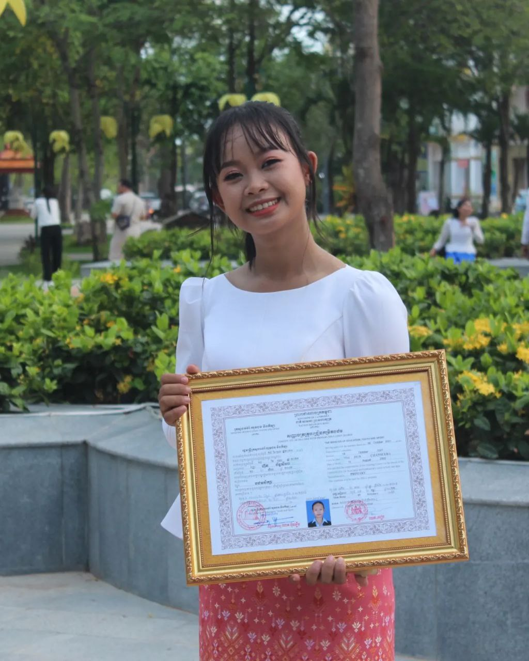
English grade 5
Chapter 3 School and Family
Unit 5 In The Morning
When do you go to school?
Student’s book page 62

Slide 2
school
សាលារៀន

Slide 3
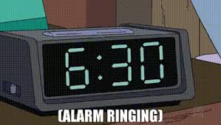
6:30
Six thirty
ម៉ោង ៦:៣០នាទី

Slide 4
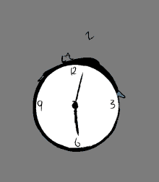
6 o’clock
ម៉ោង ៦

Slide 5
Listen and repeat
When do you go to school?
តើអ្នកទៅសាលារៀននៅម៉ោងប៉ុន្មាន?

Slide 6
Listen and repeat
I go to school at 6:30 in the morning.
ខ្ញុំទៅសាលារៀននៅម៉ោង 6:30 ព្រឹក។

Slide 7
Pair work
When do you go to school?
I go to school at 6:30 in the morning.
6:30, 6:10, 6:20, 6 o’clock, 7 o’clock...…

Slide 8
Group work
6:30, 6:10, 6:20, 6 o’clock, 7 o’clock...…
1
When do you go to school?
I go to school at …… in the morning.
When do you go to school?
4
I go to school at 6:30 in the morning.
When do you go to school?
2
I go to school at …… in the morning.
When do you go to school?
3

Slide 9
By Hun chanseyha

