Slide 1
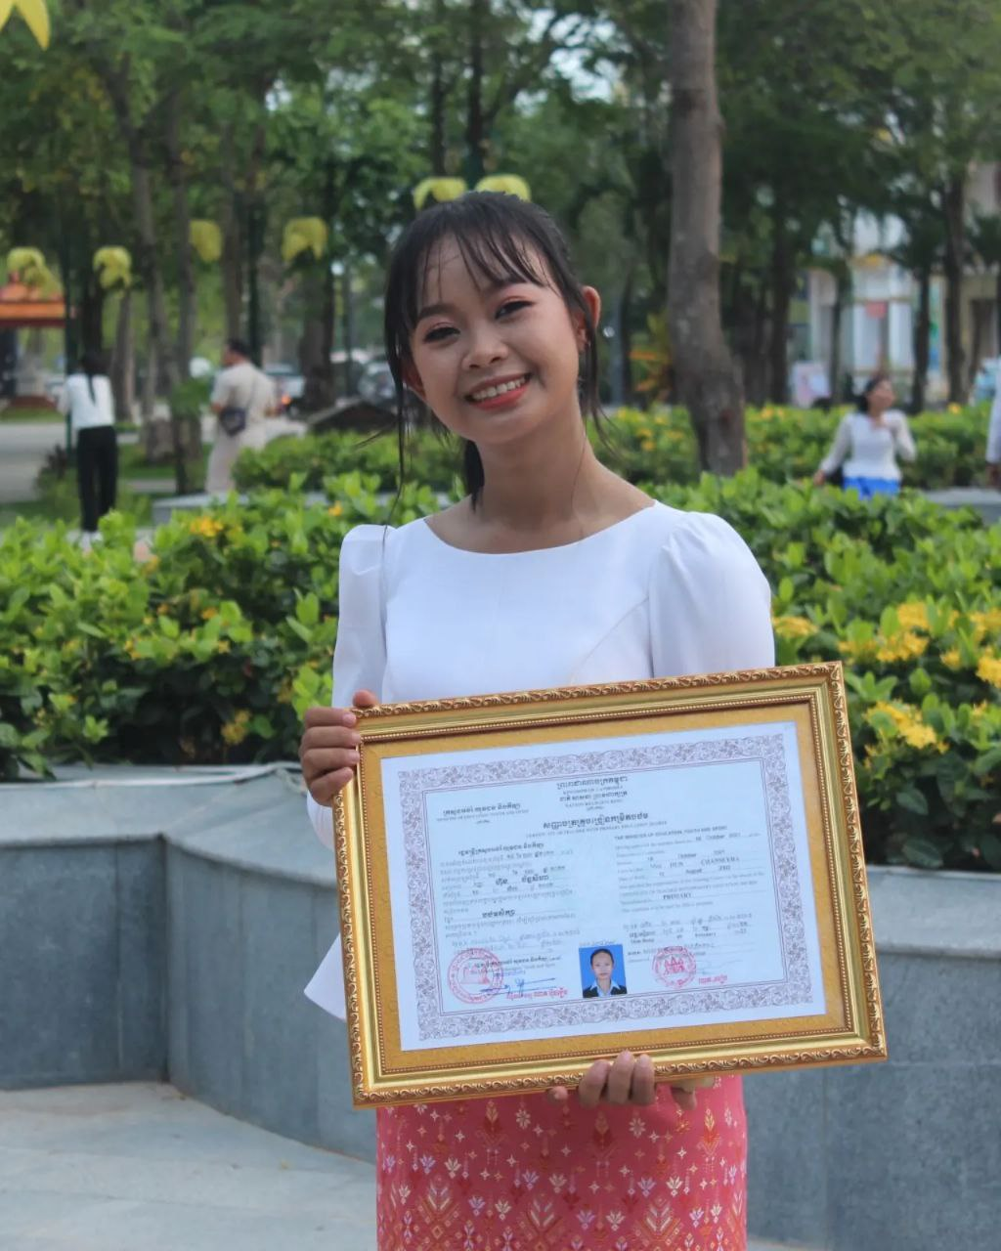
English grade 5
Chapter 4 Buying
Unit 1 Buying Fruit
Where can I buy durian?
Student’s book 68

Slide 2
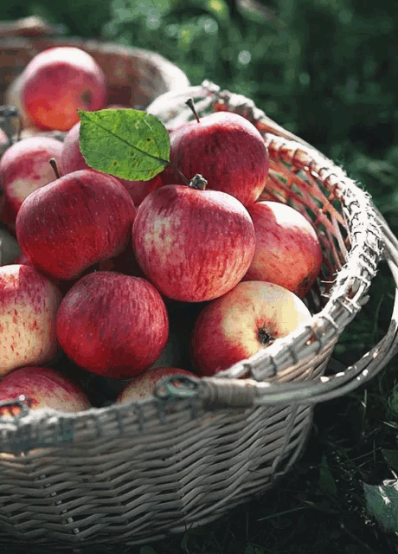
Apple
ផ្លែប៉ោម

Slide 3
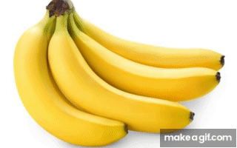
Banana
ផ្លែចេក

Slide 4
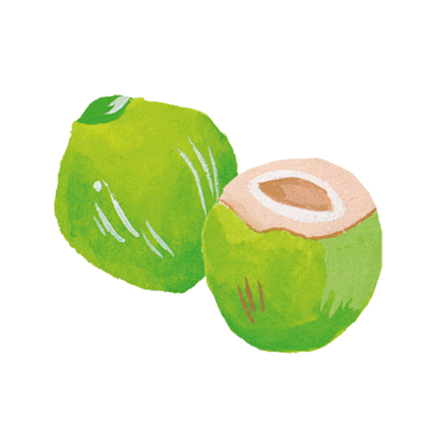
Coconut
ផ្លែដូង

Slide 5
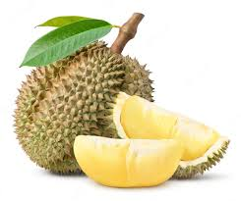
Durian
ផ្លែទុរេន

Slide 6
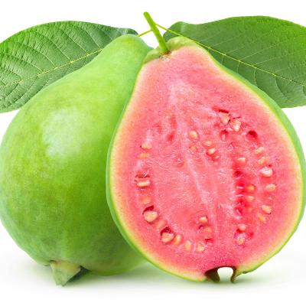
Guava
ផ្លែត្របែក

Slide 7
Listen and repeat
Where can I buy durian?
តើខ្ញុំអាចទិញផ្លែទុរេននៅឯណា?

Slide 8
Listen and repeat
You can buy durian at Mony’s shop.
អ្នកអាចទិញផ្លែទុរេននៅតូបរបស់មុនី

Slide 9
Pair work
Where can I buy durian?
You can buy durian at Mony’s shop.
Durian, guava, apple, banana, coconut. orange.....

Slide 10
Group work
Durian, guava, apple, banana, coconut. orange.....
1
Where can I buy durian?
You can buy ………. at Mony’s shop.
Where can I buy ………..?
4
You can buy durian at Mony’s shop.
Where can I buy …………?
2
You can buy ………. at Mony’s shop.
Where can I buy ………..?
3

Slide 11
By Hun chanseyha

