Slide 1
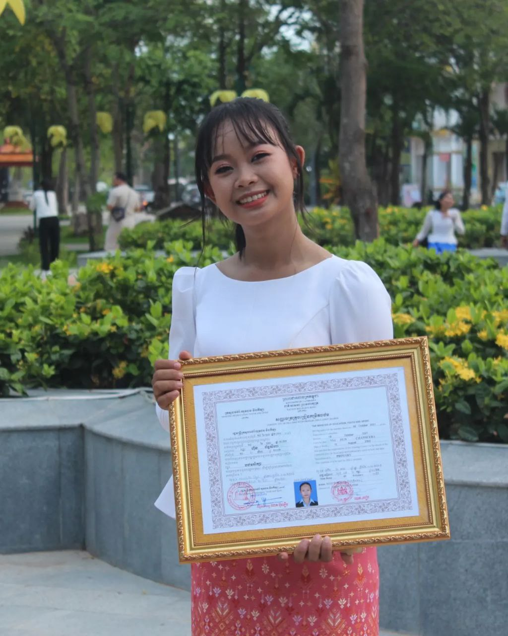
English grade 5
Chapter 4 Buying
Unit 5 Numbers 20-99
Is that a banana?
Student’s book page 84 85

Slide 2
That is
នោះ គឺជា

Slide 3
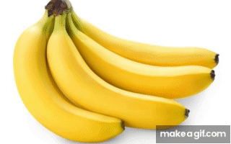
Banana
ផ្លែចេក

Slide 4
Listen and repeat
Is that a banana?
តើនោះគឺជាផ្លែចេកមែនទេ?

Slide 5
Listen and repeat
Yes, that is / No, that is not
ចាស, នោះគឺជាផ្លែចេក
ទេ,​ នោះមិនមែនទេ

Slide 6
Pair work
Is that a banana?
Yes, that is / No, that is not
Banana, mango, orange, durian, computer….

Slide 7
Group work
Banana, mango, orange, durian, computer….
1
Is that a banana?
Yes, that is / No, that is not
Is that a ………..?
4
Yes, that is / No, that is not
Is that an orange?
2
Yes, that is / No, that is not
Is that a ………..?
3

Slide 8
By Hun chanseyha

