Slide 1

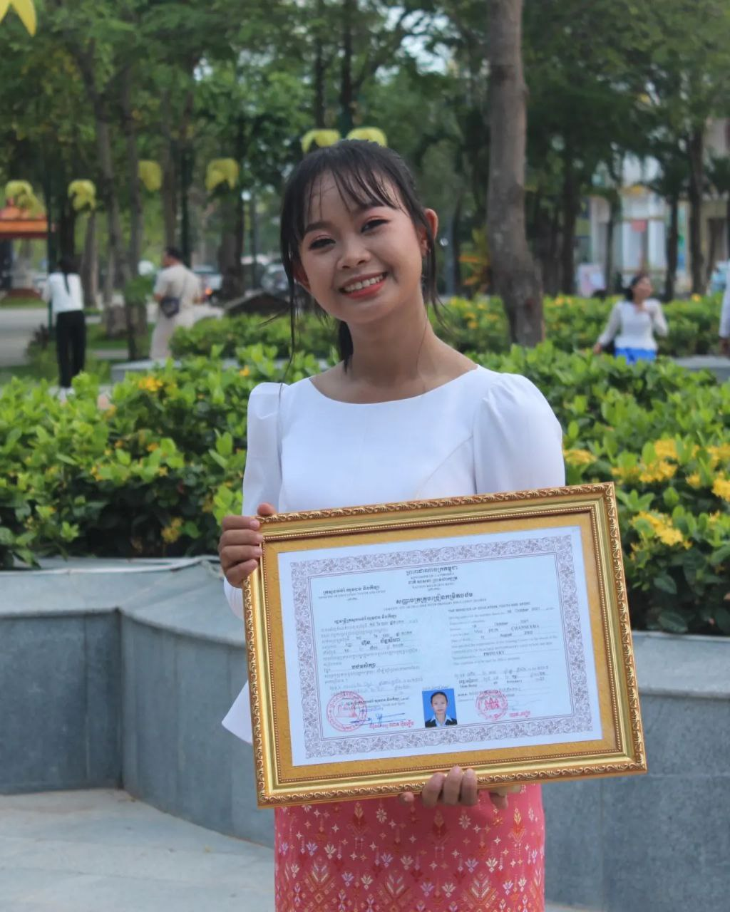
English grade 6
Chapter 3 My Body
Unit 4 Body Functions
What can you do?

Slide 2
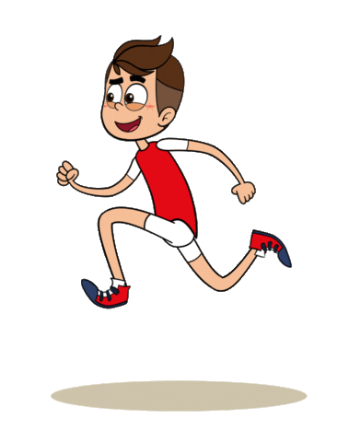
Run
រត់

Slide 3
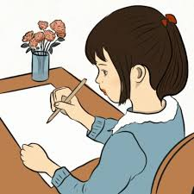
Write
សរសេរ

Slide 4

Eat
ញ៉ាំ

Slide 5
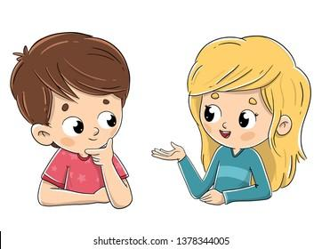
Listen and repeat
What can you do?
តើអ្នកអាចធ្វើអ្វីបាន?

Slide 6
Listen and repeat
I can run.
ខ្ញុំអាចរត់។

Slide 7
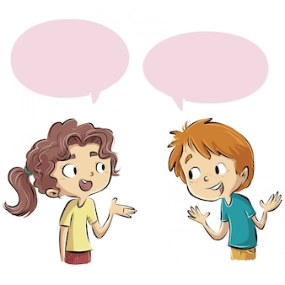
Pair work
What can you do?
I can run.

Slide 8
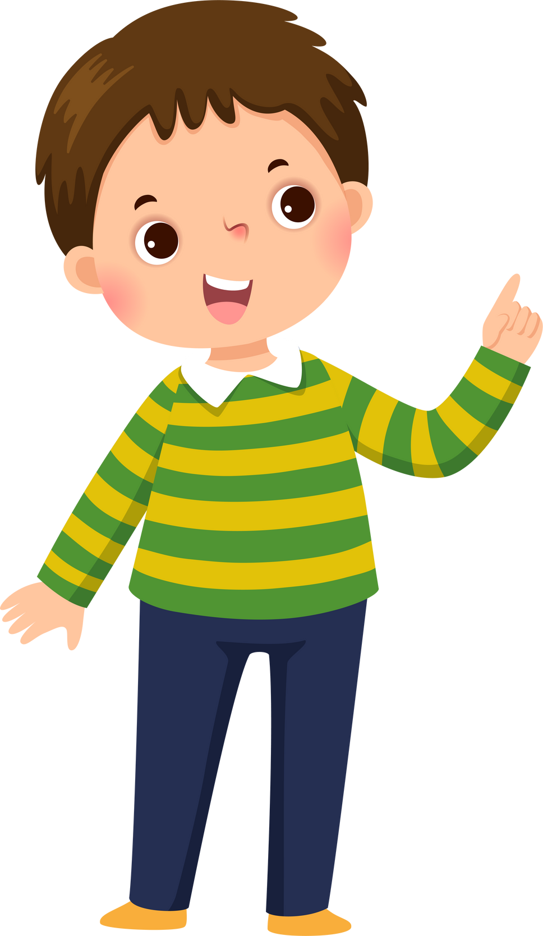

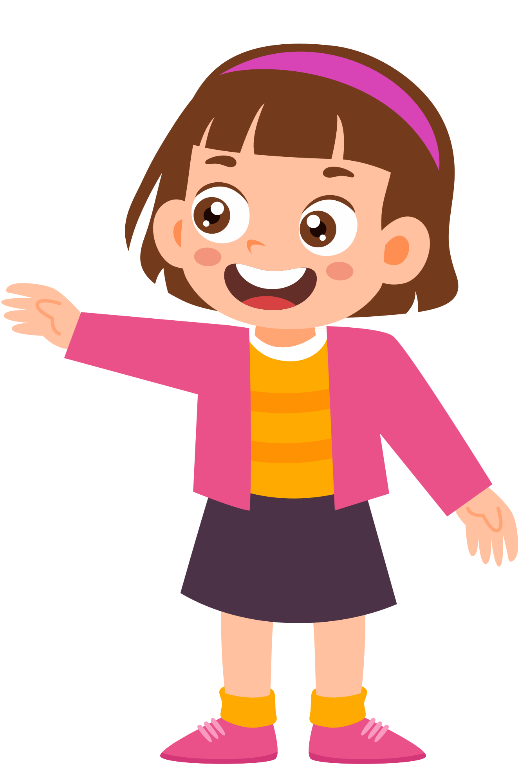
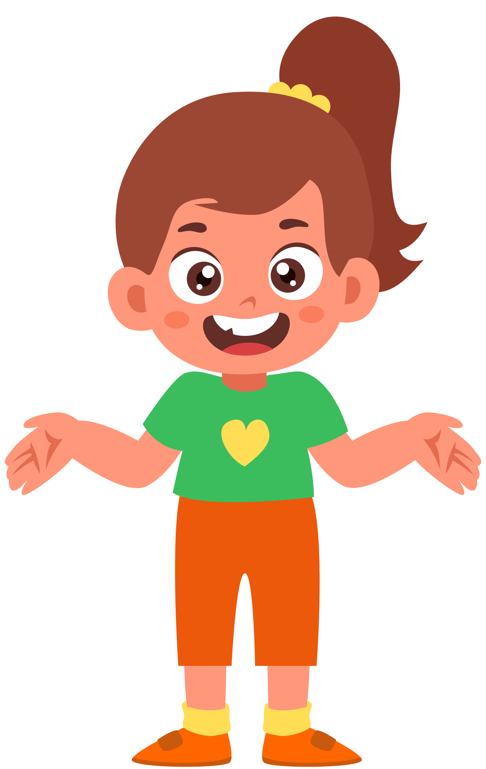
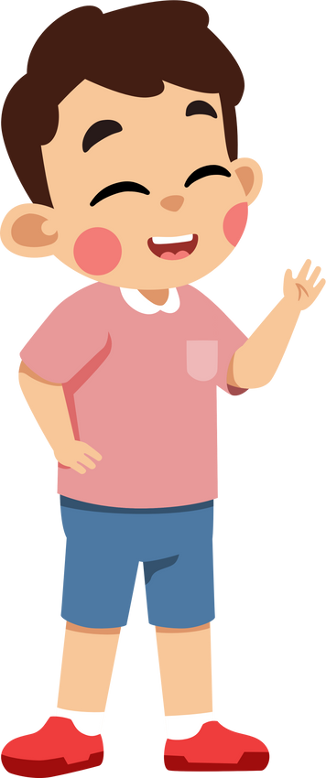
Group work
Eat-see-run-write-play-walk-read
1
What can you do?
I can ………….
What can you do?
4
I can run.
What can you do?
2
I can ………….
What can you do?
3

Slide 9


By Hun chanseyha

