Slide 1

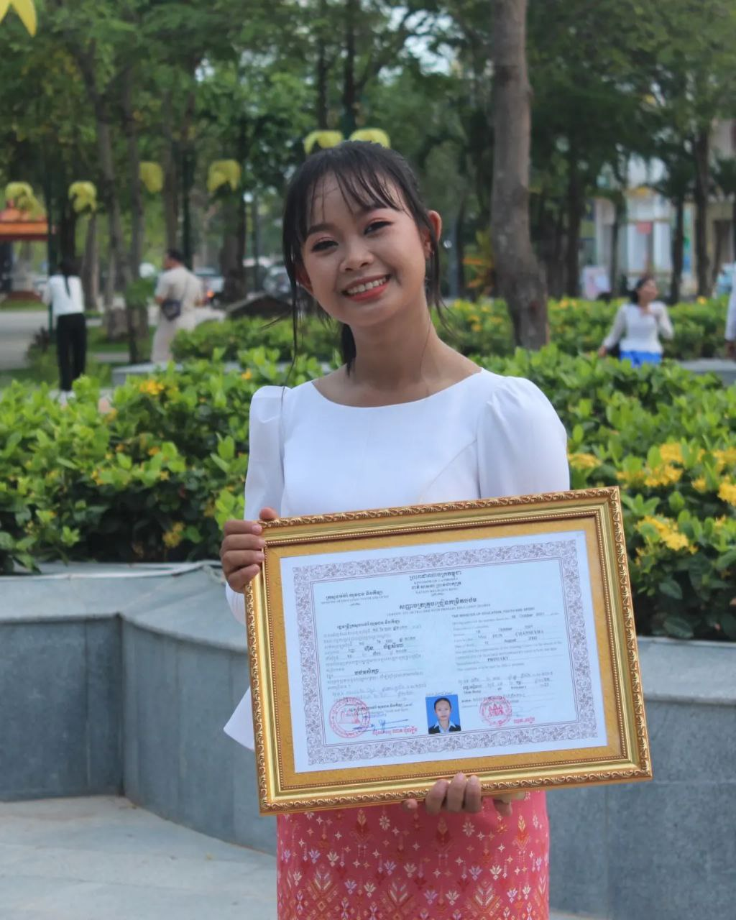
English grade 6
Chapter 1 Time and activities
Unit 1 Greeting and Introductions
What is your name?
Student’s book Page 9

Slide 2
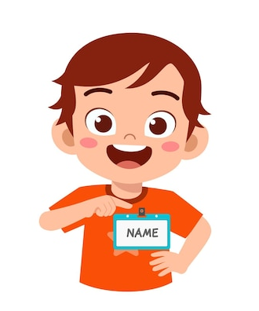

Name
ឈ្មោះ

Slide 3

My
របស់ខ្ញុំ

Slide 4

Listen and repeat
What is your name?
តើអ្នកឈ្មោះអ្វី?

Slide 5
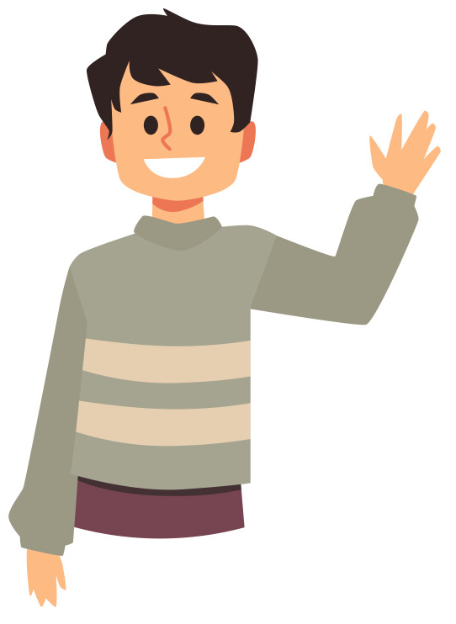
Listen and repeat
My name is Seyha.
ខ្ញុំឈ្មោះ សីហា

Slide 6
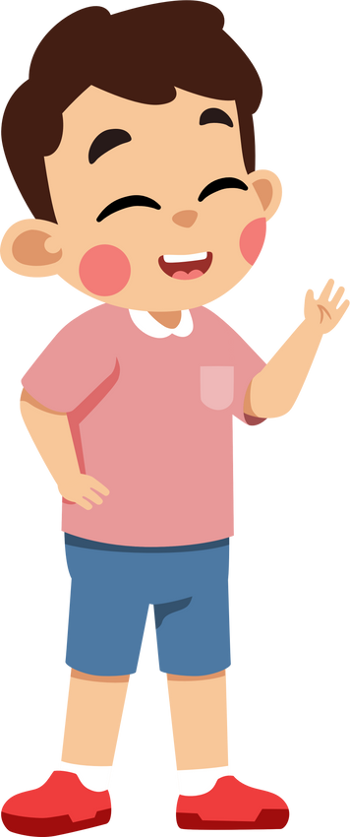
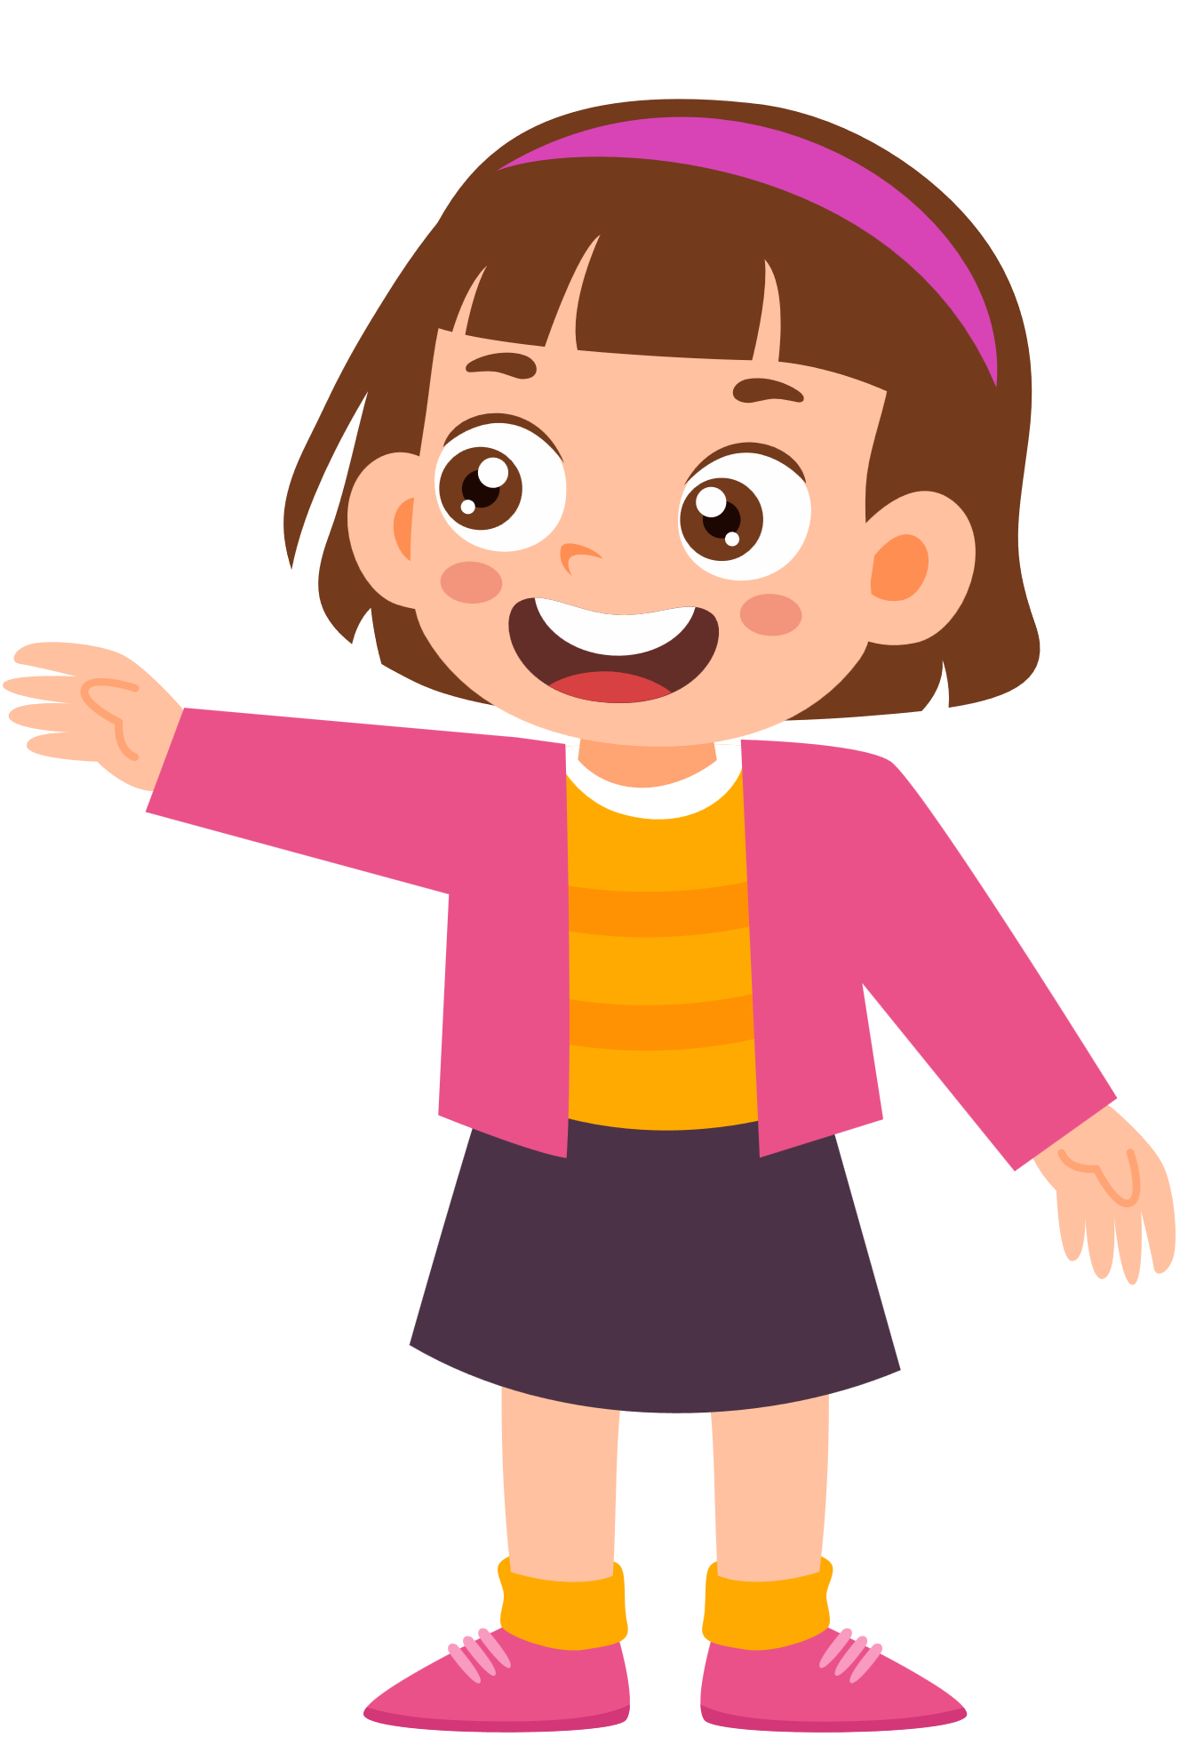
Pair work
What is your name?
My name is ……..

Slide 7
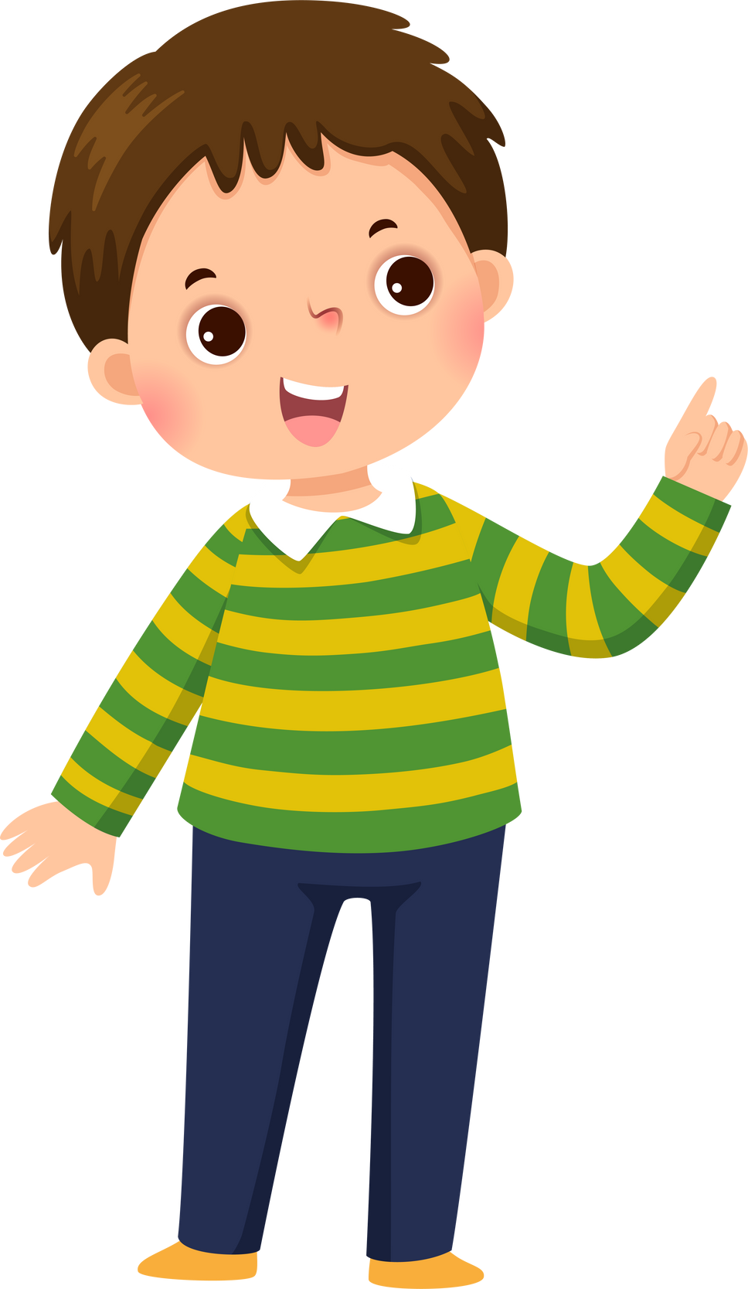

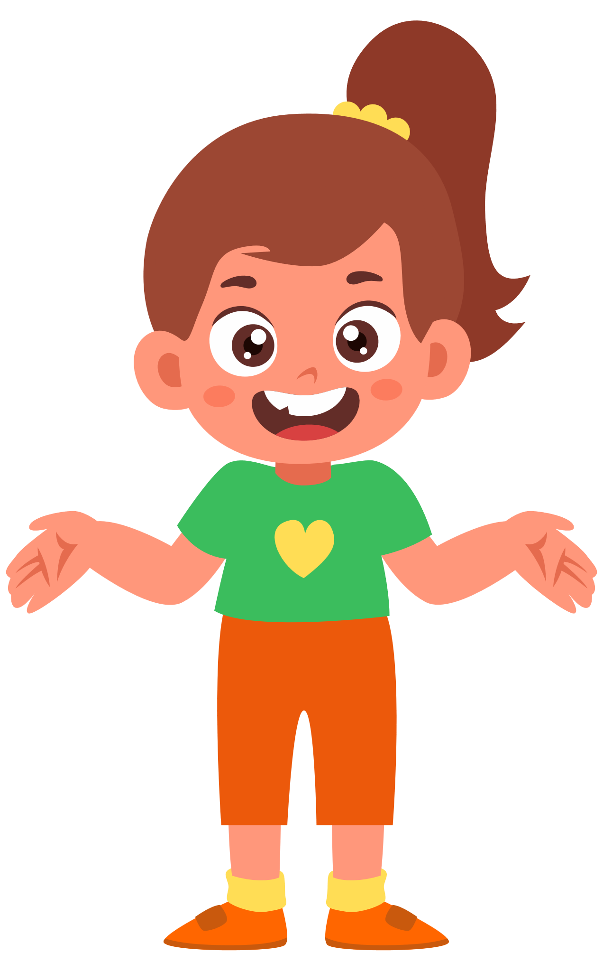
Group work
1
What is your name?
My name is ………..
What is your name?
4
My name is Seyha.
What is your name?
2
My name is ………..
What is your name?
3

Slide 8


By Hun chanseyha

