Slide 1

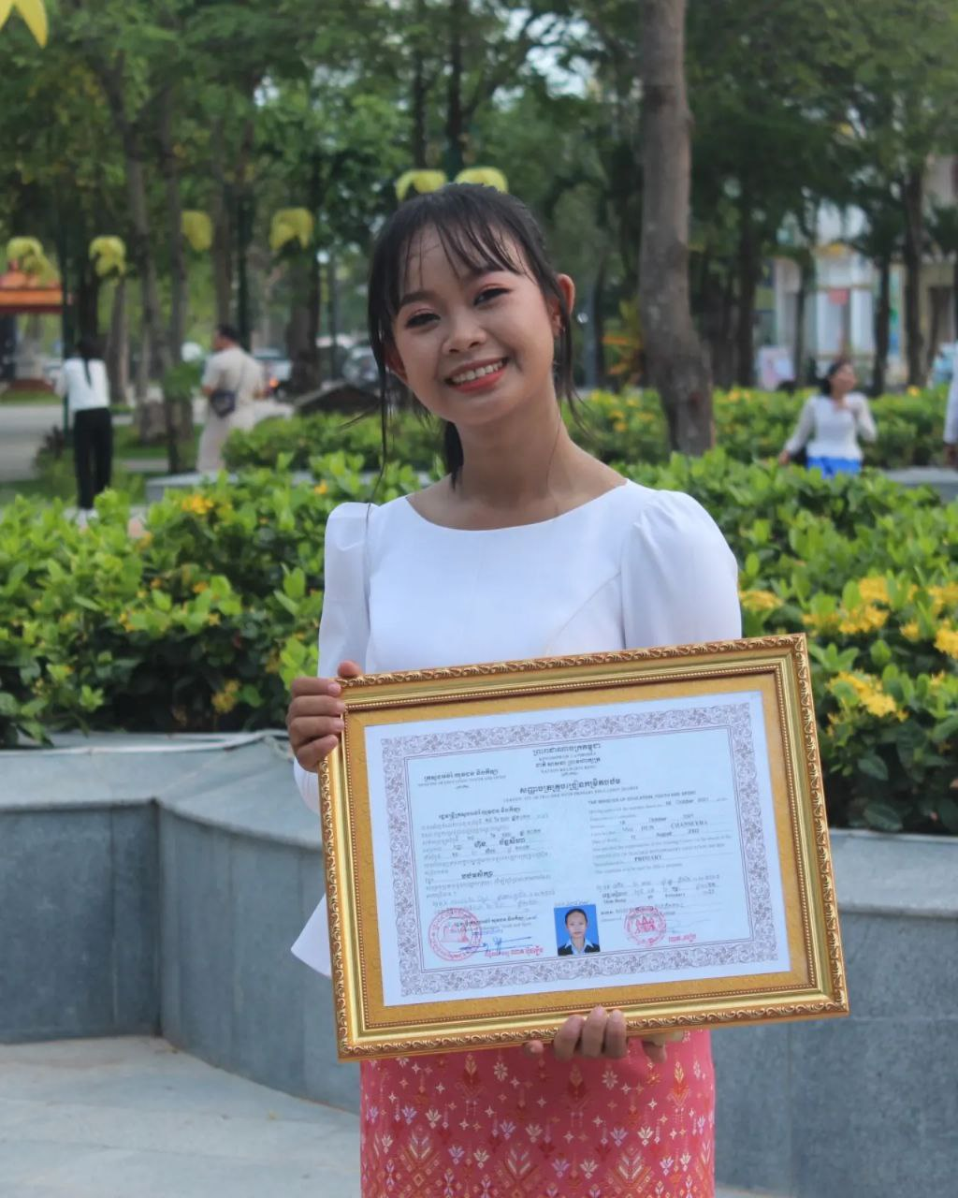
English grade 6
Chapter 1 Time and activities
Unit 1 Greeting and Introductions
How are you?
Student’s book Page 9

Slide 2


Hello
សួស្ដី

Slide 3

Fine
សុខសប្បាយ

Slide 4

Thank you
អរគុណ

Slide 5

Listen and repeat
How are you ?
តើអ្នកសុខសប្បាយទេ?

Slide 6

Listen and repeat
I’m fine. Thank you
ខ្ញុំសុខសប្បាយទេ អរគុណច្រើន

Slide 7
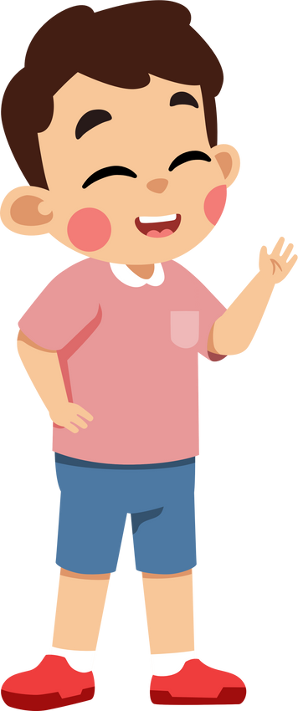
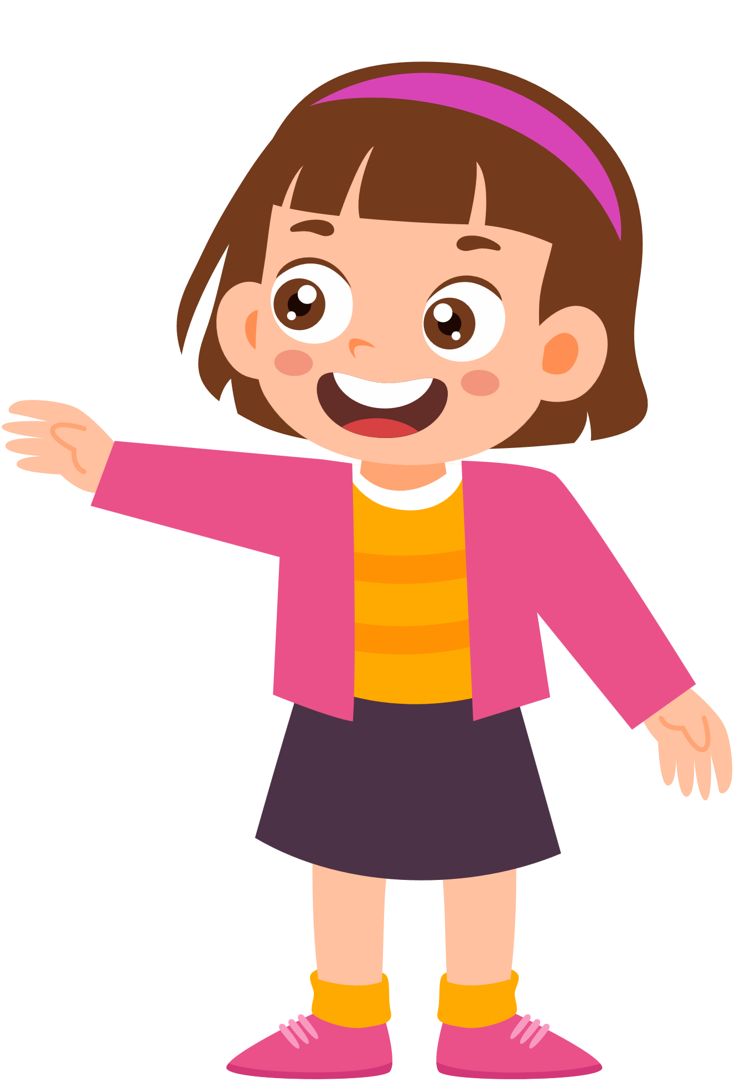
Pair work
Hello, how are you?
I’m fine. Thank you

Slide 8
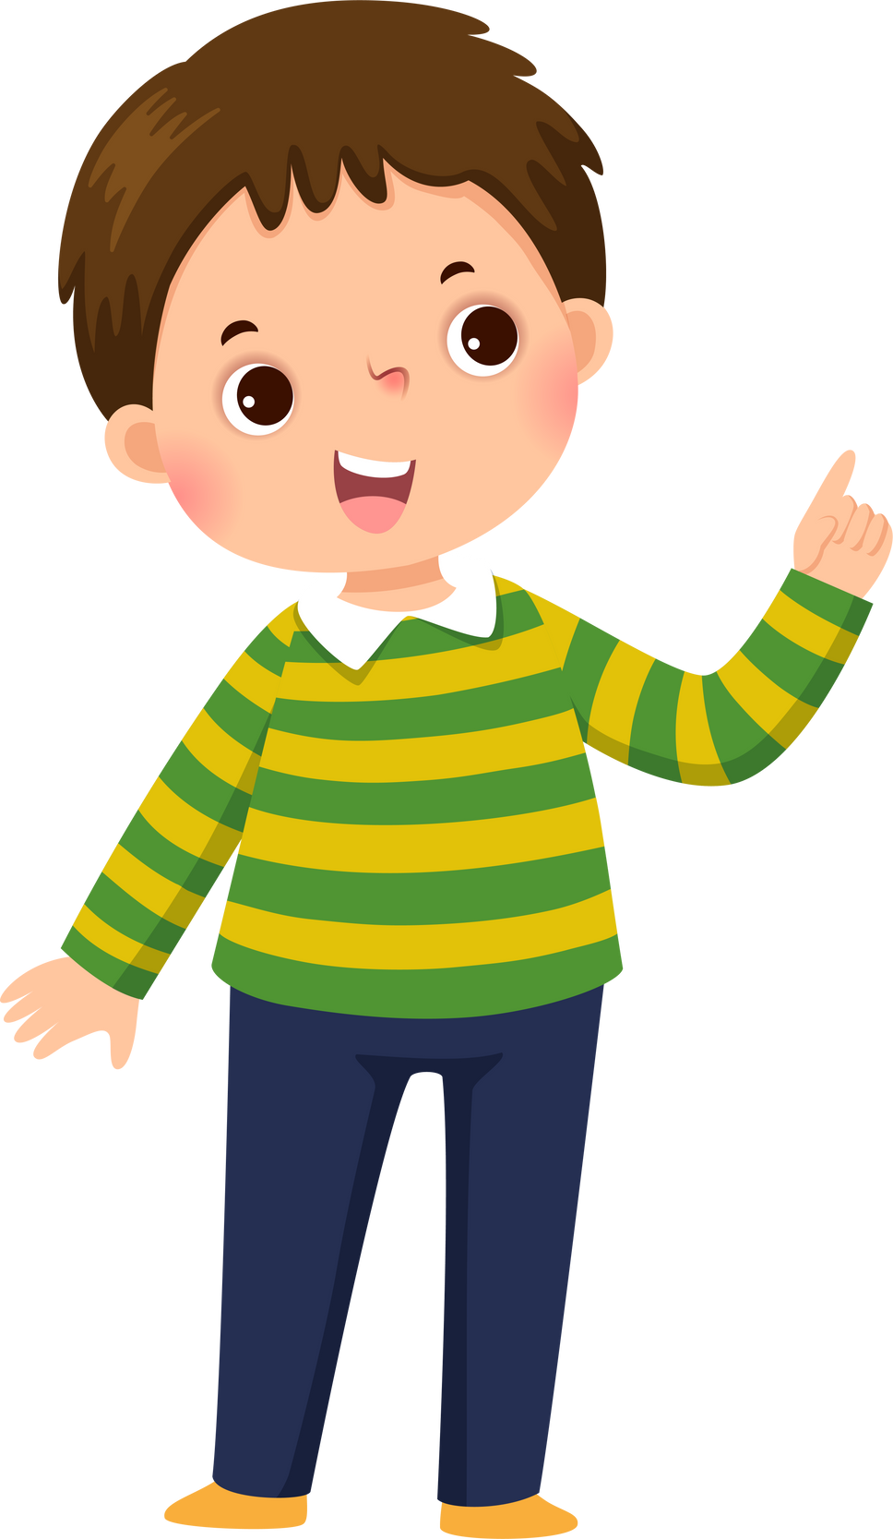

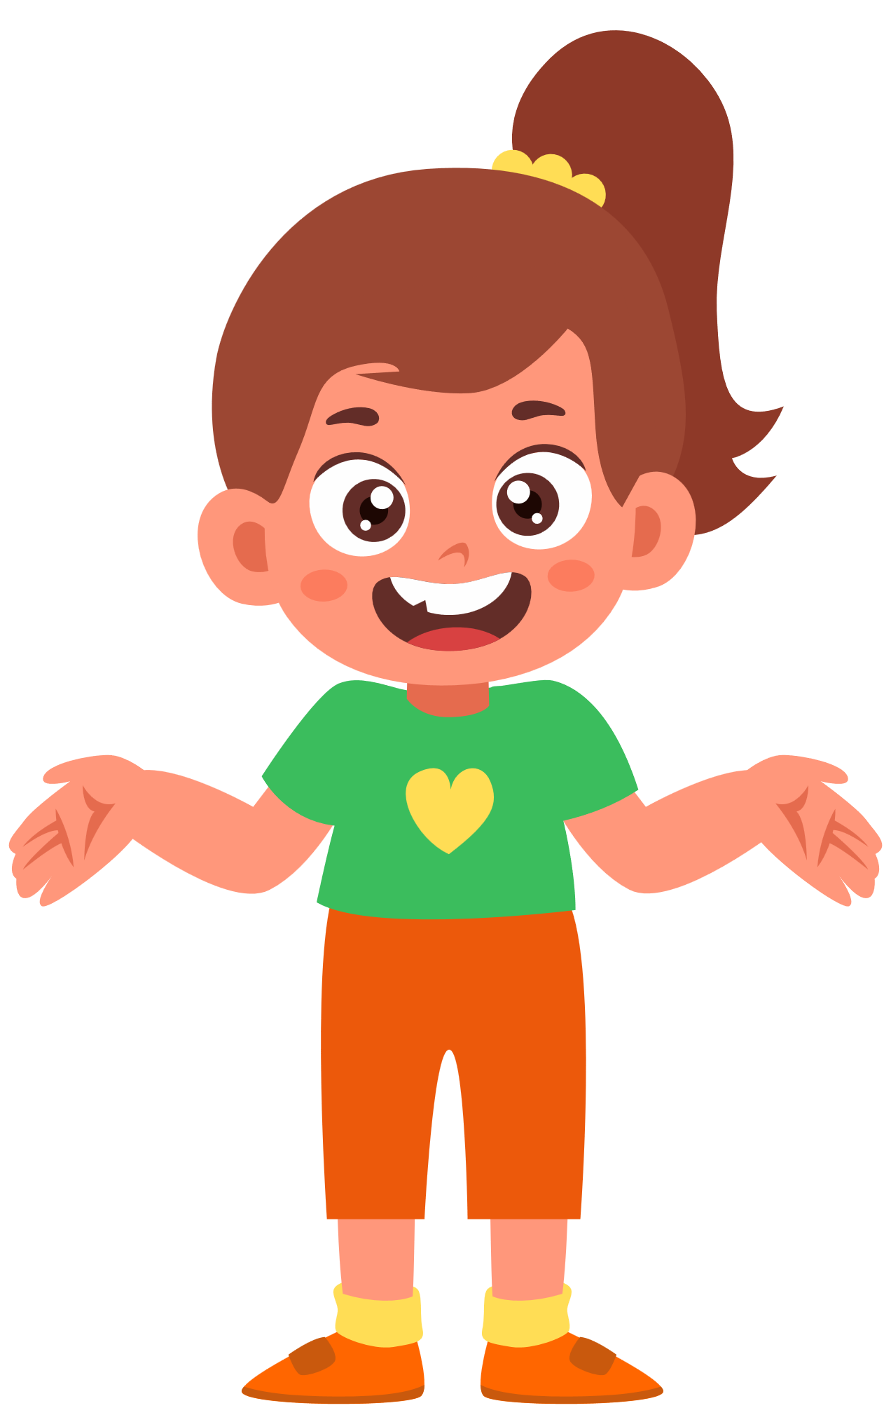
Group work
1
Hello Seyha, how are you?
I’m fine. Thank you
………, how are you?
4
I’m fine. Thank you
………, how are you?
2
I’m fine. Thank you
………, how are you?
3

Slide 9


By Hun chanseyha

