Slide 1

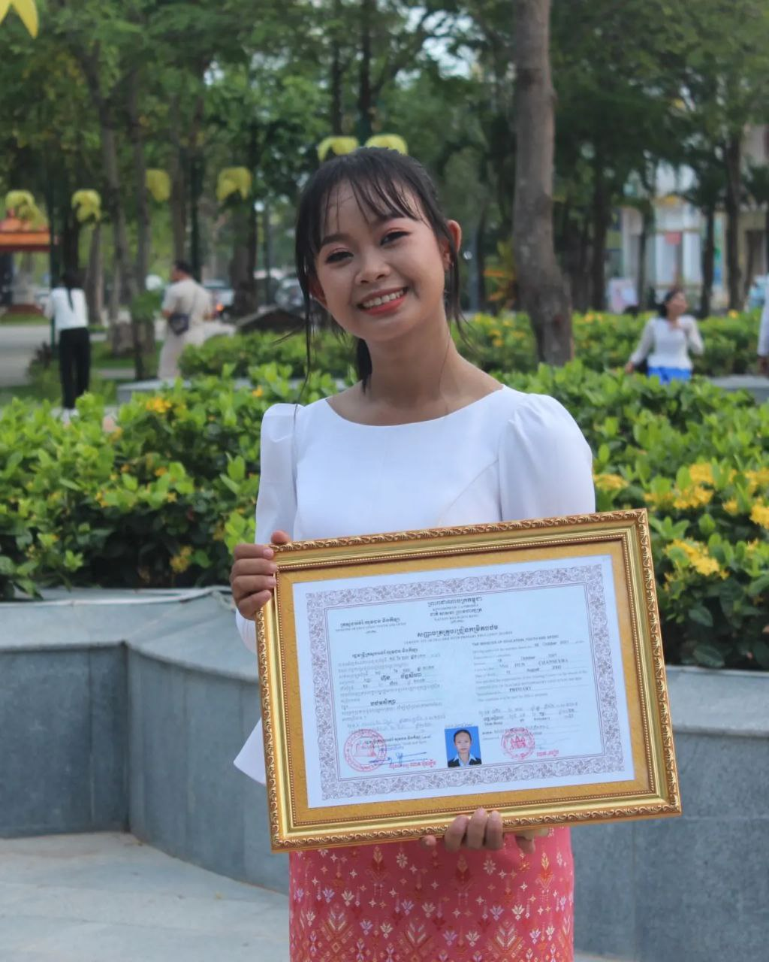
English grade 6
Chapter 1 Time and activities
Unit 3 Feeling happy
How do you go to school?
Student’s book Page 9

Slide 2

school
សាលារៀន

Slide 3
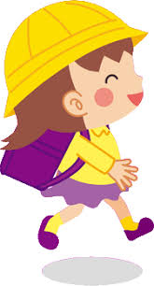

go
ទៅ

Slide 4
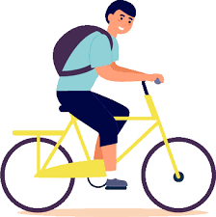
By bike
ដោយជិះកង់

Slide 5
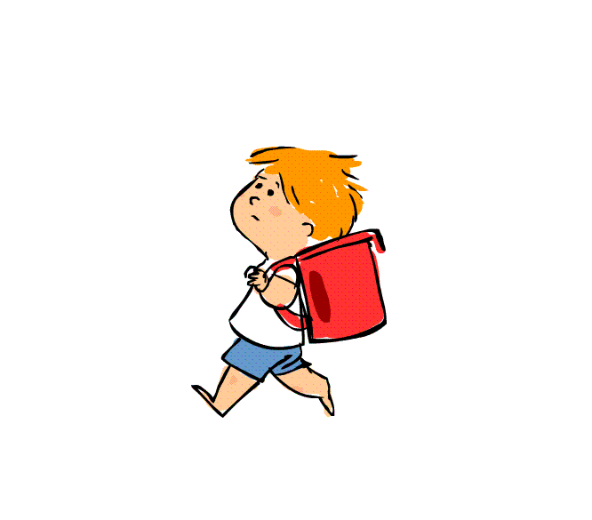
On foot
ដោយដើរ

Slide 6

Listen and repeat
How do you go to school?
តើអ្នកទៅសាលាដូចម្ដេច?

Slide 7

Listen and repeat
I go to school by bike
ខ្ញុំទៅសាលាដោយជិះកង់

Slide 8
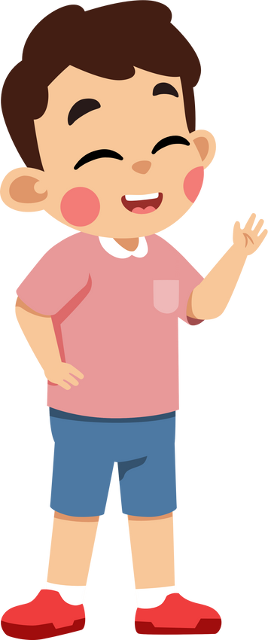
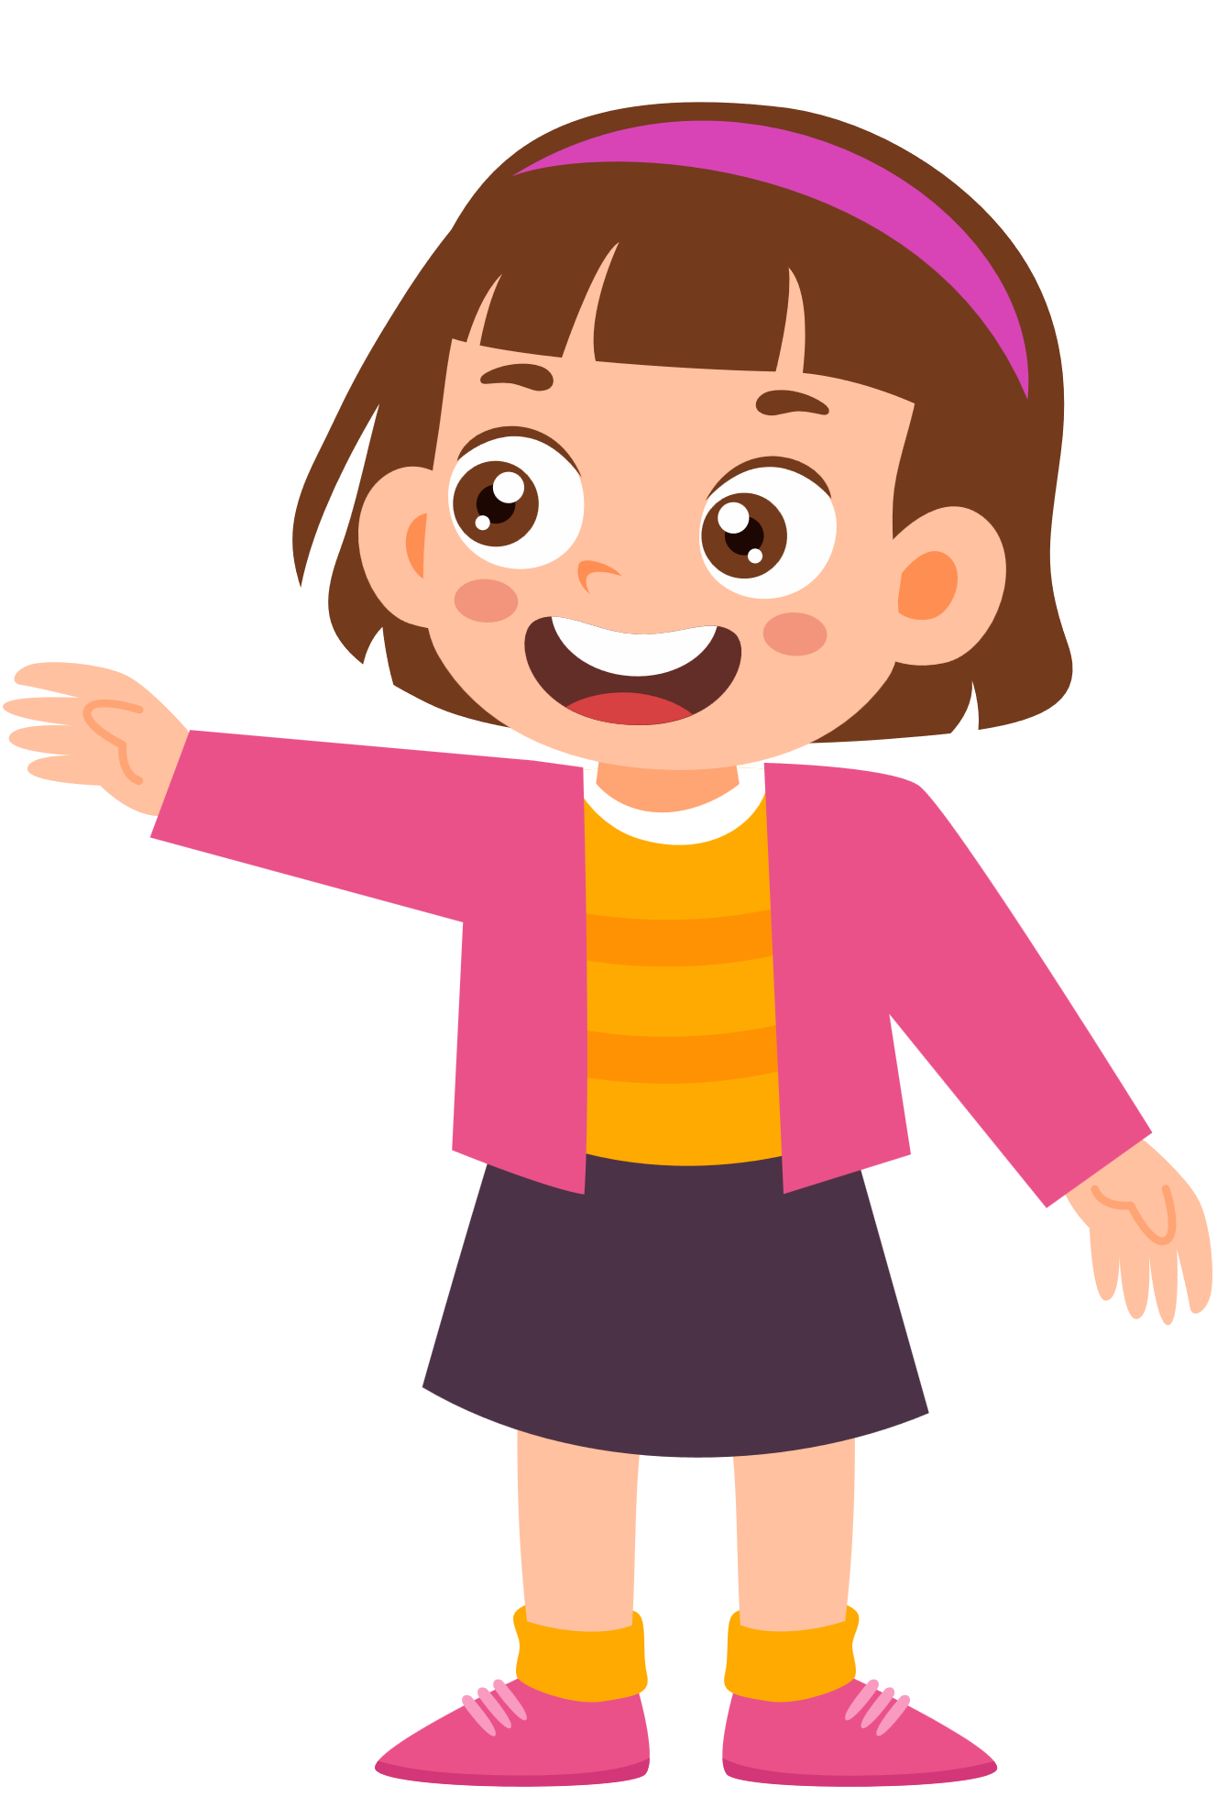
Pair work
How do you go to school?
I go to school by bike.

Slide 9
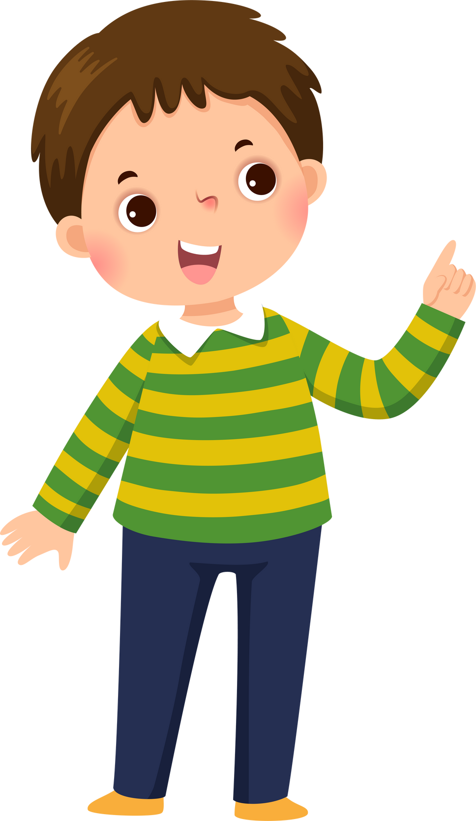

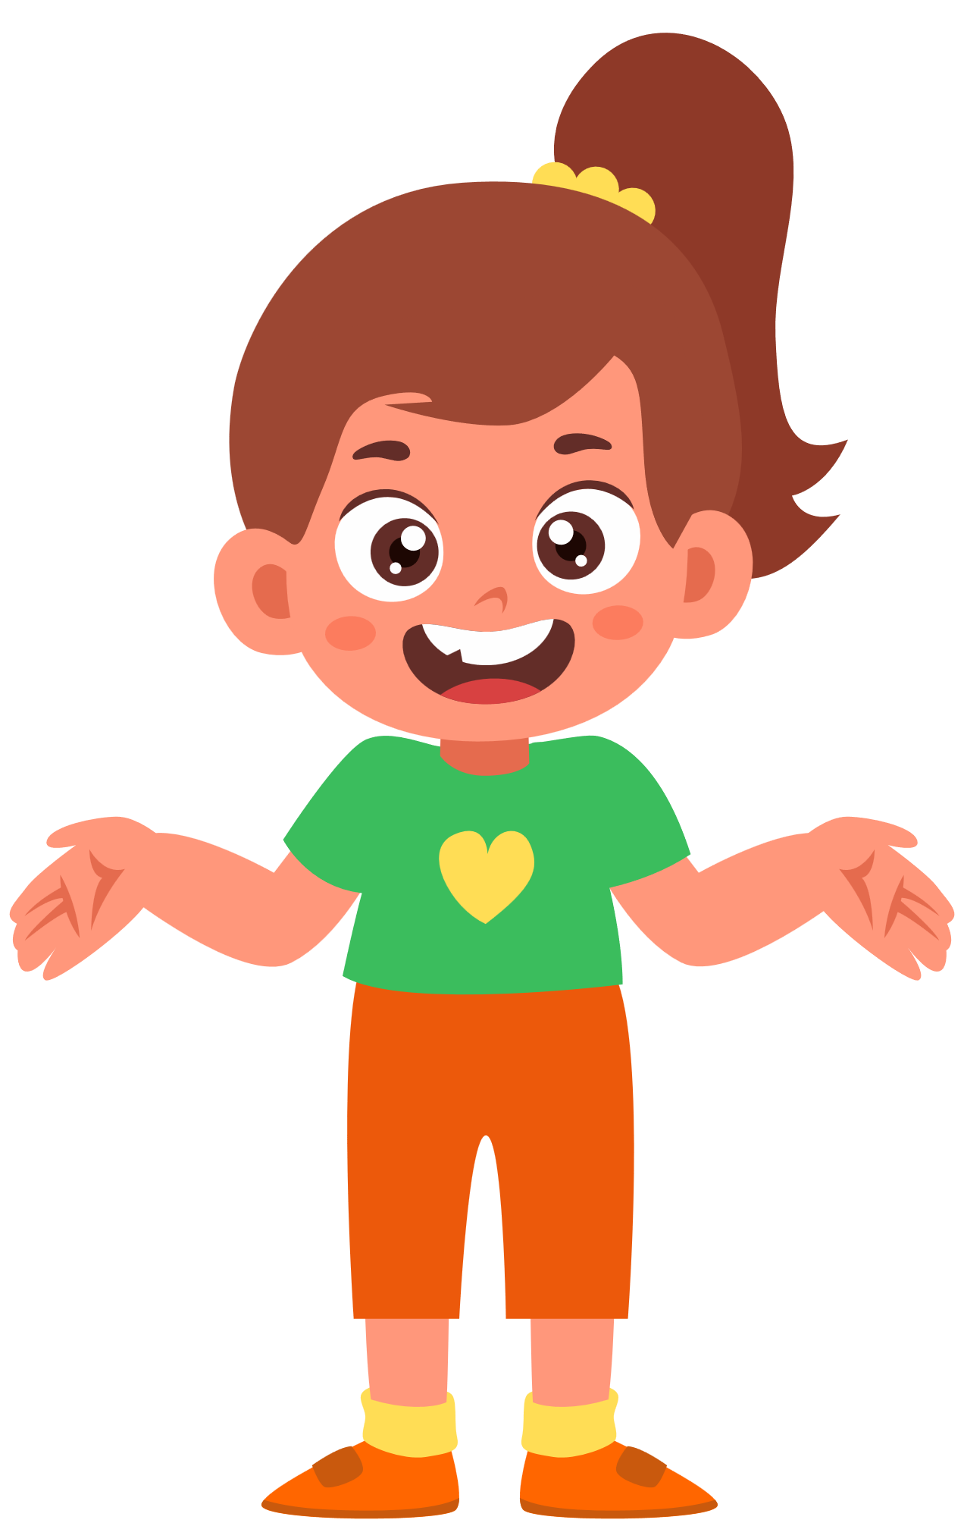
Group work
1
How do you go to school?
I go to school by……….
how do you go to school?
4
I go to school by bike.
how do you go to school?
2
I go to school on foot.
how do you go to school?
3

Slide 10


By Hun chanseyha

