Slide 1
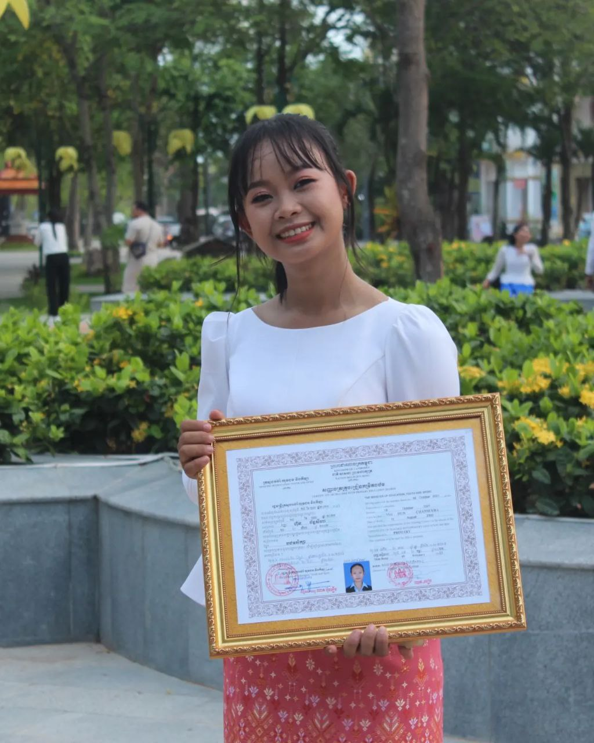
English grade 6
Chapter 1 Time and activities
Unit 1 Greeting and Introductions
How old are you?
Student’s book Page 9

Slide 2
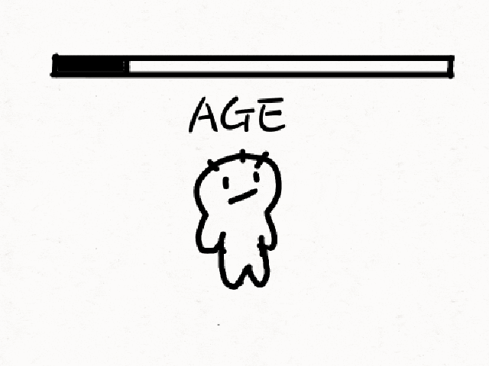
Years old
អាយុ

Slide 3
Listen and repeat
How old are you?
តើអ្នកមានអាយុប៉ុន្មាន?

Slide 4
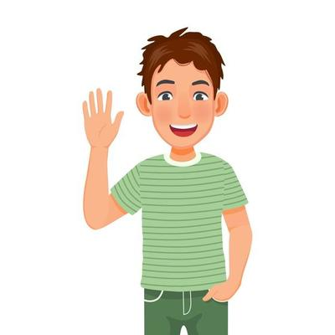
Listen and repeat
I am 12 years old.
ខ្ញុំមានអាយុ ១២ ឆ្នាំ

Slide 5
Pair work
How old are you?
I am …….. years old.

Slide 6
Group work
1
How old are you?
I am ………. years old.
How old are you?
4
I am 11 years old.
How old are you?
2
I am ………. years old.
How old are you?
3

Slide 7
By Hun chanseyha

