Slide 1
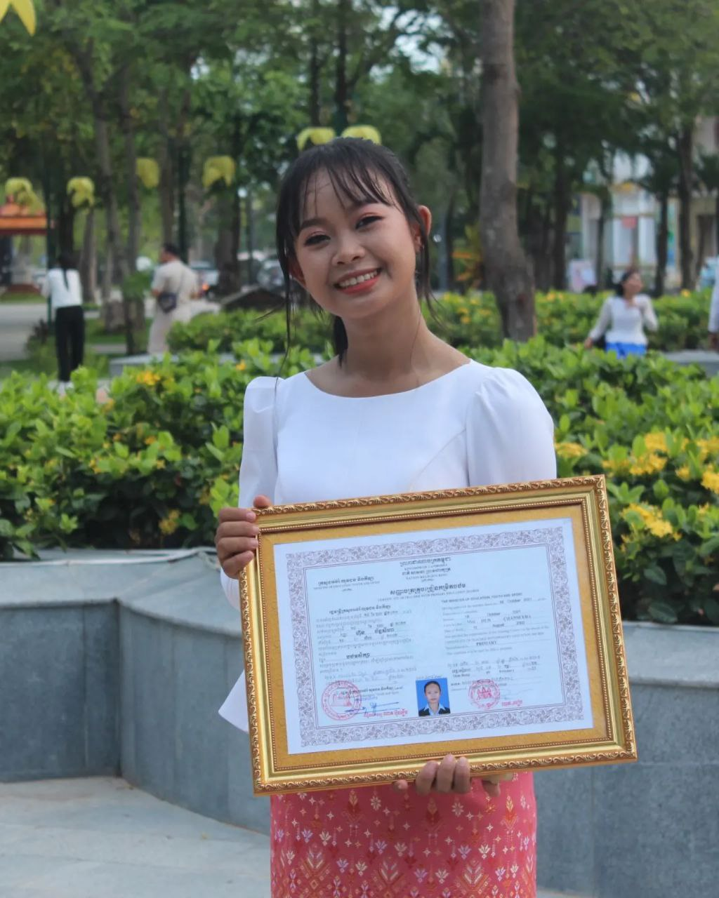
English grade 6
Chapter 1 Time and activities
Unit 2 Telling the time
What do you like to do?

Slide 2
Like
ចូលចិត្ត

Slide 3
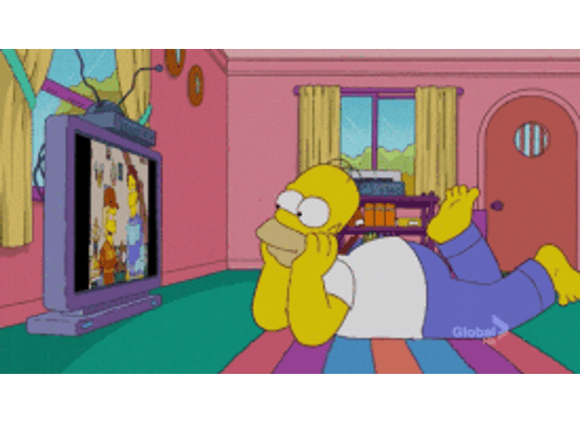
Watch TV
មើលទូរទស្សន៍

Slide 4
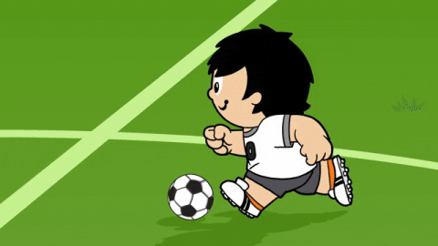
Play football
លេងបាល់ទាត់

Slide 5
Listen and repeat
What do you like to do?
តើអ្នកចូលចិត្តធ្វើអ្វី?

Slide 6
Listen and repeat
I like watching TV.
ខ្ញុំចូលចិត្តមើលទូរទស្សន៍

Slide 7
Listen and repeat
What do you like to do?
I like watching TV.

Slide 8
Group work
Watching TV, reading, playing football, cooking, eating
1
What do you like to do?
I like ……………...
What do you like to do?
4
I like watching TV.
What do you like to do?
2
I like ……………….
What do you like to do?
3

Slide 9
By Hun chanseyha

