Slide 1
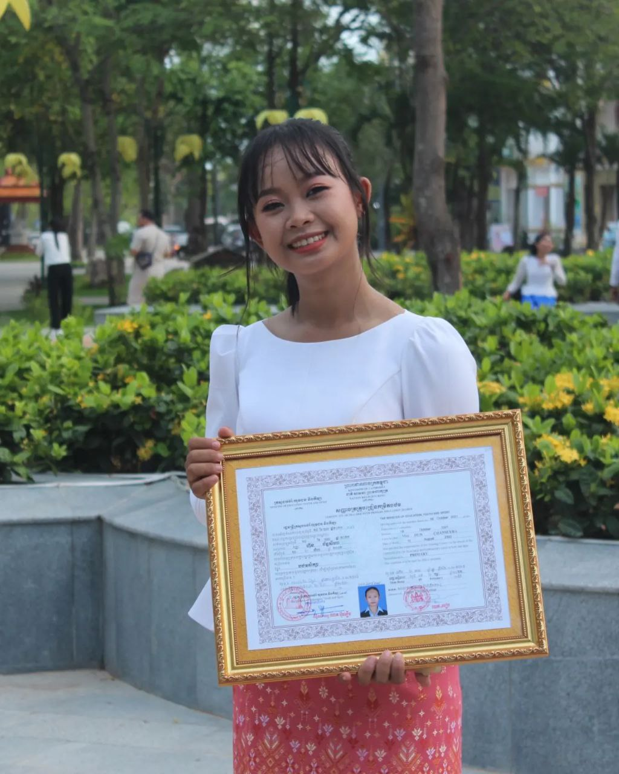
English grade 6
Chapter 1 Time and activities
Unit 4 Time at home
What do you do in the morning?

Slide 2
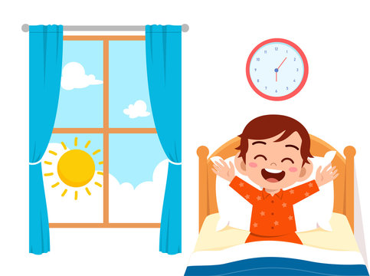
morning
ពេលព្រឹក

Slide 3
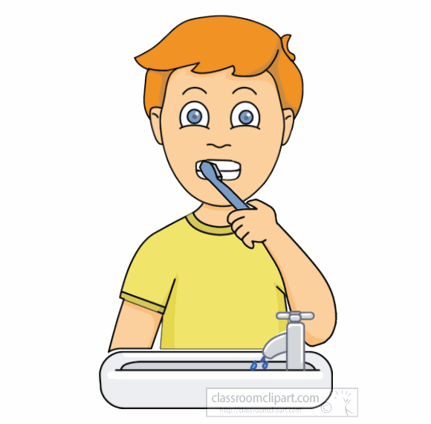
Brush the teeth
ដុសធ្មេញ

Slide 4
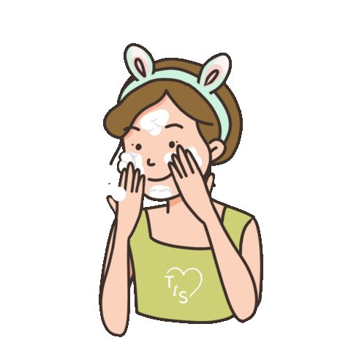
Wash my face
លុប​មុខ(របស់ខ្ញុំ)

Slide 5
Listen and repeat
What do you do in the morning?
តើអ្នកធ្វើអ្វីនៅពេលព្រឹក?

Slide 6
Listen and repeat
I brush my teeth.
ខ្ញុំដុសធ្មេញ
Brush my teeth, clean the house, wash my face, take a shower

Slide 7
Pair work
What do you do in the morning?
I brush my teeth.
Brush my teeth, clean the house, wash my face, take a shower

Slide 8
Group work
Brush my teeth, clean the house, wash my face, take a shower
1
What do you do in the morning?
I ……………….
What do you do in the morning?
4
I brush my teeth.
What do you do in the morning?
2
I ………………...
What do you do in the morning?
3

Slide 9
By Hun chanseyha

