Slide 1
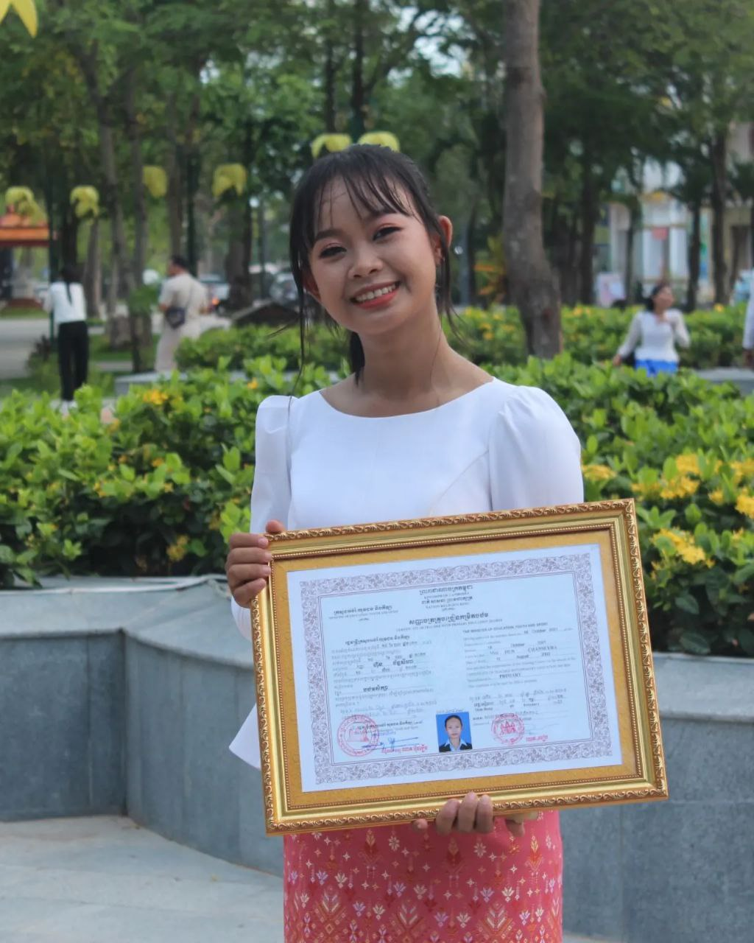
English grade 6
Chapter 1 Time and activities
Unit 4 Time at home
What do you do in the evening?

Slide 2
Evening
ពេលល្ងាច

Slide 3
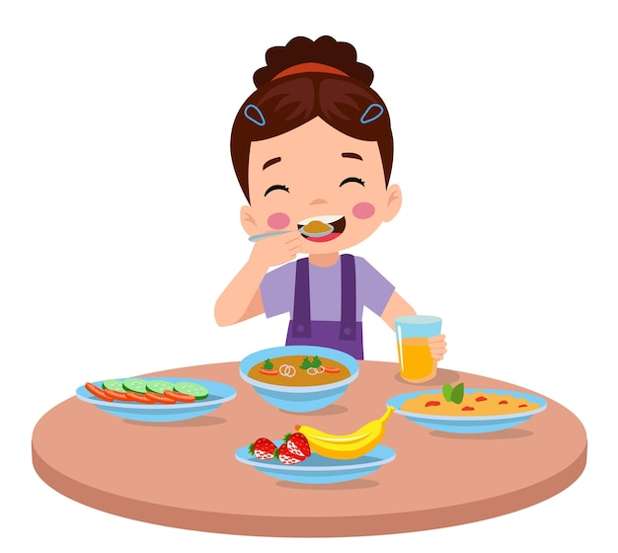
Have dinner
ញ៉ាំបាយល្ងាច

Slide 4
Study
រៀន

Slide 5
Listen and repeat
What do you do in the evening?
តើអ្នកធ្វើអ្វីនៅពេលល្ងាច?

Slide 6
Listen and repeat
I have dinner.
ខ្ញុំញ៉ាំបាយល្ងាច

Slide 7
Pair work
What do you do in the evening?
I have dinner.
Cook food-study-have dinner-do homework-watch TV

Slide 8
Group work
Cook food-study-have dinner-do homework-watch TV
1
What do you do in the evening?
I ………….
What do you do in the evening?
4
I do homework
What do you do in the evening?
2
I ……………...
What do you do in the evening?
3

Slide 9
By Hun chanseyha

