Slide 1
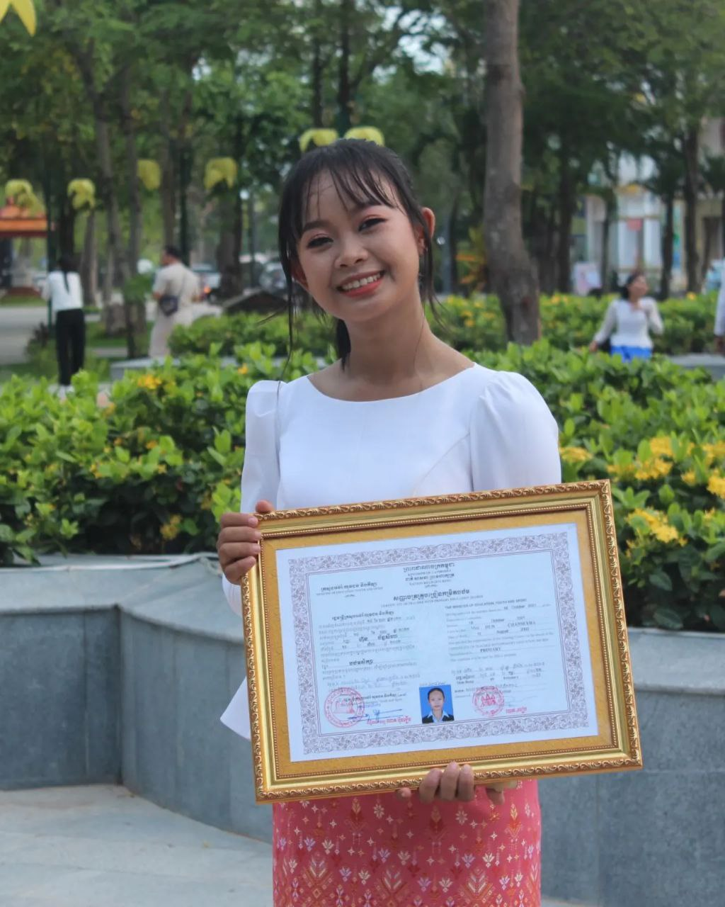
English grade 6
Chapter 1 Time and activities
Unit 2 Time at school
What do you do at school?

Slide 2
Study English
រៀនភាសាអង់គ្លេស

Slide 3
Read a book
អានសៀវភៅ

Slide 4
Listen and repeat
What do you do at school?
តើអ្នកធ្វើអ្វីនៅសាលារៀន?

Slide 5
Listen and repeat
I study English.
ខ្ញុំរៀនភាសាអង់គ្លេស

Slide 6
Pair work
What do you do at school?
I study English.
Read a book-play football-play sport-study Khmer

Slide 7
Group work
Read a book-play football-play sport-study Khmer
1
What do you do at school?
I …………..
What do you do at school?
4
I study English.
What do you do at school?
2
I …………...
What do you do at school?
3

Slide 8
By Hun chanseyha

