Slide 1
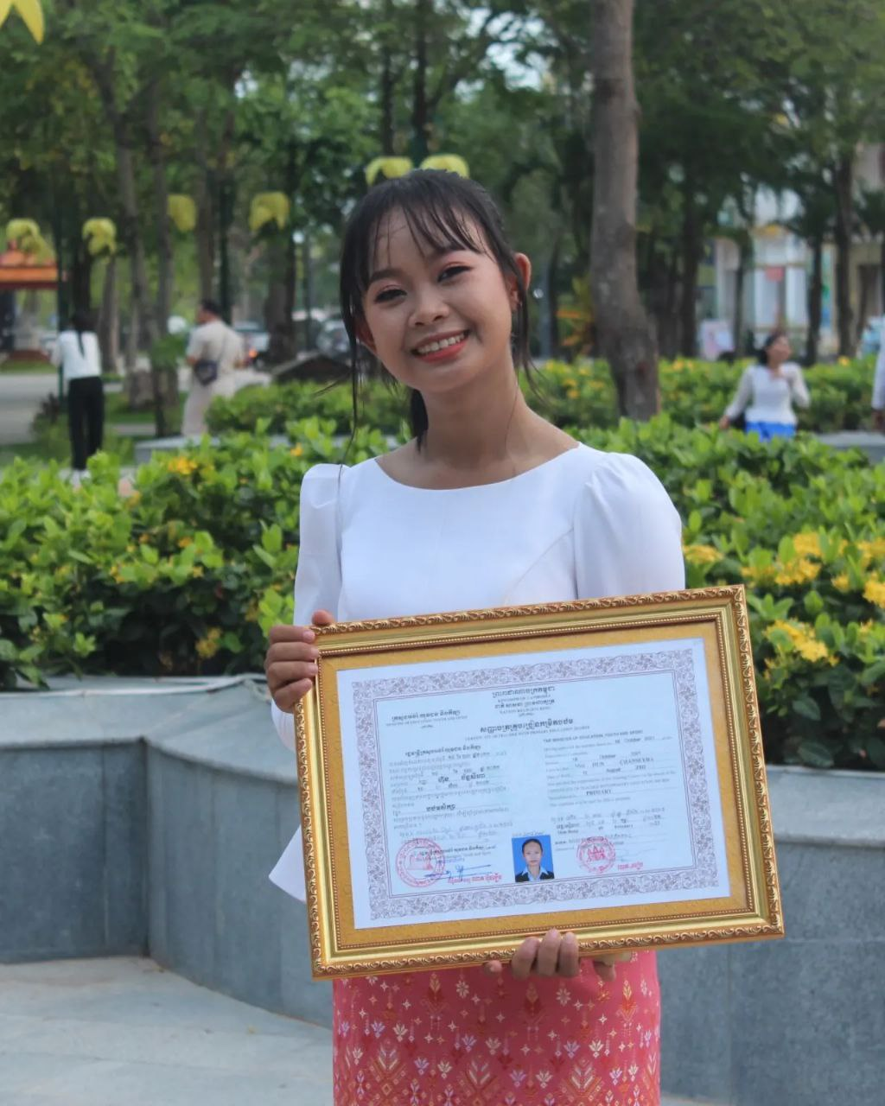
English grade 6
Chapter 2 The date
Unit 1 The days
What day is today?

Slide 2
ថ្ងៃអាទិត្យ

Slide 3
ថ្ងៃចន្ទ

Slide 4
ថ្ងៃអង្គារ

Slide 5
ថ្ងៃពុធ

Slide 6
ថ្ងៃព្រហស្បតិ៍

Slide 7
ថ្ងៃសុក្រ

Slide 8
ថ្ងៃសៅរ៍

Slide 9
Listen and repeat
What day is it today?
តើថ្ងៃនេះជាថ្ងៃអ្វី?

Slide 10
Listen and repeat
Today is Monday.
ថ្ងៃនេះជាថ្ងៃចន្ទ

Slide 11
Pair work
What day is today?
Today is Monday.

Slide 12
Group work
Monday, Tuesday, Wednesday, Thursday, Friday, Saturday, Sunday
Group work
Monday, Tuesday, Wednesday, Thursday, Friday, Saturday, Sunday
1
What day is today?
Today is ………...
What day is today?
4
Today is Monday.
What day is today?
2
Today is ………...
What day is today?
3

Slide 13
By Hun chanseyha

