Slide 1
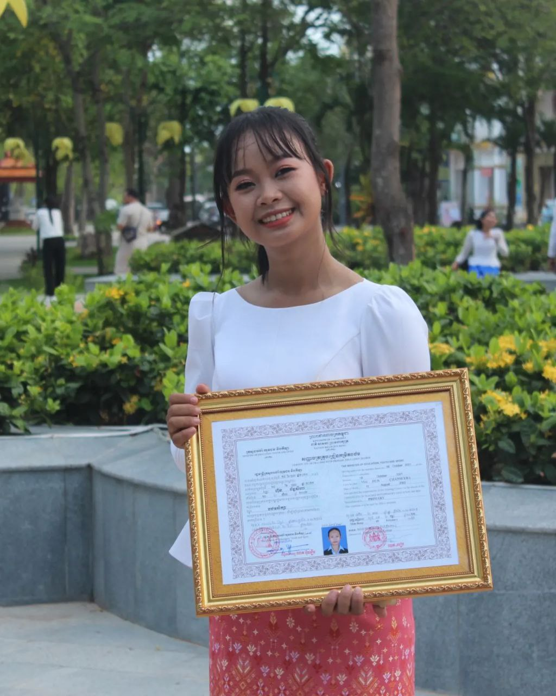
English grade 6
Chapter 2 The date
Unit 2 The Months
What month is it now?

Slide 2
ខែមករា

Slide 3
ខែកុម្ភៈ

Slide 4
ខែមីនា

Slide 5
ខែមេសា

Slide 6
ខែឧសភា

Slide 7
ខែមិថុនា

Slide 8
ខែកក្កដា

Slide 9
ខែសីហា

Slide 10
ខែកញ្ញា

Slide 11
ខែតុលា

Slide 12
ខែវិច្ឆិកា

Slide 13
ខែធ្នូ

Slide 14
Listen and repeat
What month is it now?
តើខែនេះជាខែអ្វី?

Slide 15
Listen and repeat
It is July.
វាជាខែកក្កដា

Slide 16
Pair work
What month is it now?
It is July.
January February March April May June July August September October November December

Slide 17
Group work
January February March April May June July August September October November December
1
What month is it now?
It is ……….
What month is it now?
4
It is July.
What month is it now?
2
It is ……….
What month is it now?
3

Slide 18
By Hun chanseyha

