Slide 1
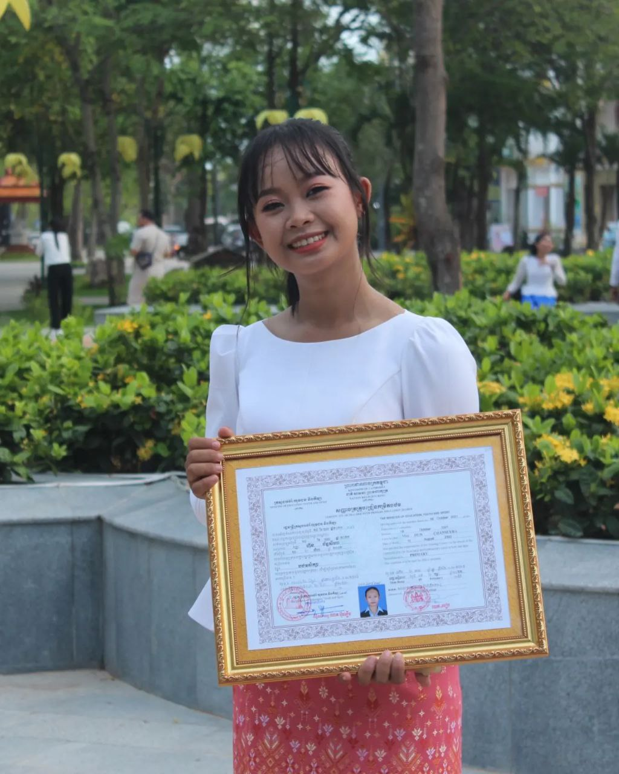
English grade 6
Chapter 2 The date
Unit 5 School Events
What subjects are you good at?

Slide 2
Subject
មុខវិជ្ជា

Slide 3
English
ភាសាអង់គ្លេស

Slide 4
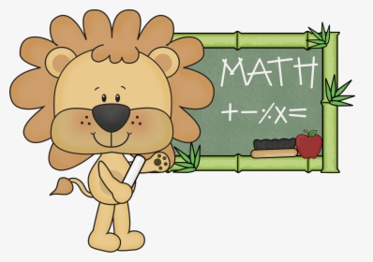
Mathematics
គណិតវិទ្យា

Slide 5
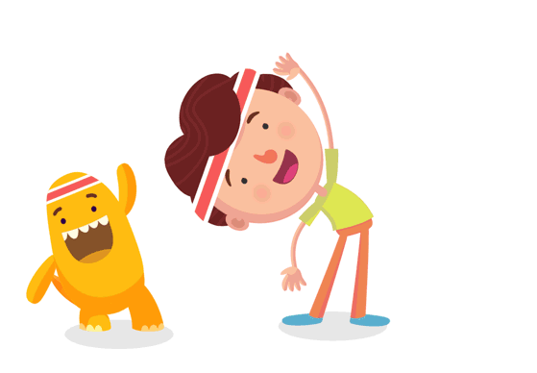
Sports
កីឡា

Slide 6
Listen and repeat
What subjects are you good at?
តើអ្នកពូកែមុខវិជ្ជាអ្វី?

Slide 7
Listen and repeat
I’m good at English.
ខ្ញុំពូកែភាសាអង់គ្លេស

Slide 8
Pair work
What subjects are you good at?
I’m good at English.
Khmer , Mathematics, Sports, science, Reading, Drawing

Slide 9
Group work
Math English Khmer Sports Science Reading Drawing
1
what subjects are you good at?
I’m good at ………...
what subjects are you good at?
4
I’m good at English.
what subjects are you good at?
2
I’m good at ………...
what subjects are you good at?
3

Slide 10
By Hun chanseyha

