Slide 1
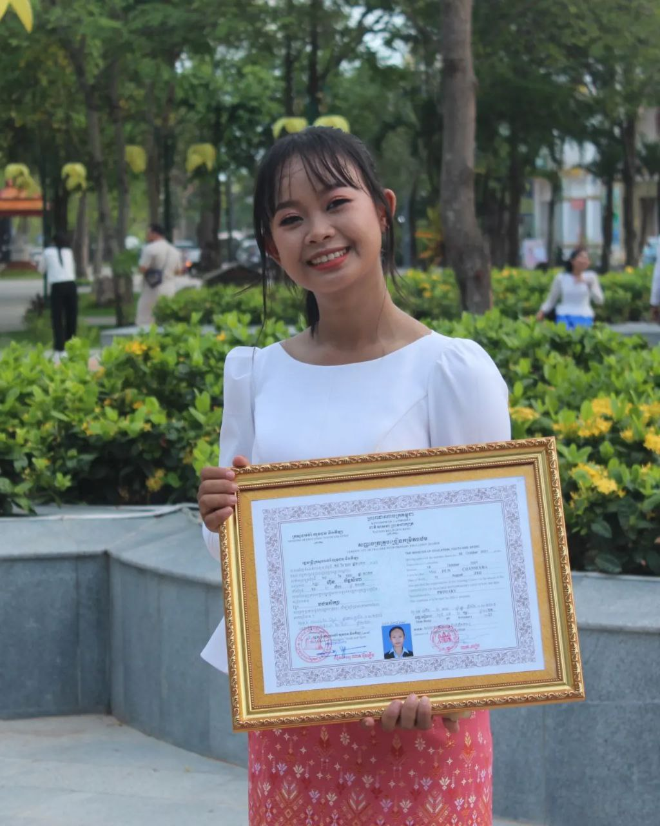


English grade 6
Chapter 1 Time and activities
Unit 2 telling the time
It is quarter to ……
Student’s book 14 15

Slide 2
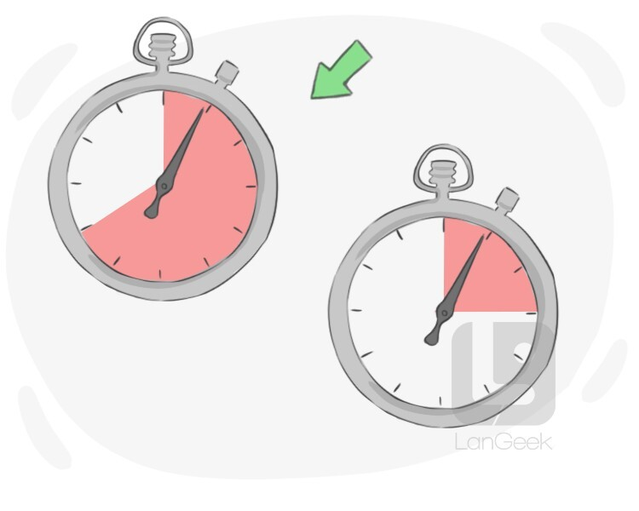
quarter (time)
¼ ឬ ១៥នាទី

Slide 3
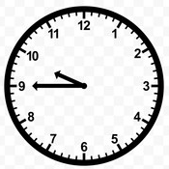
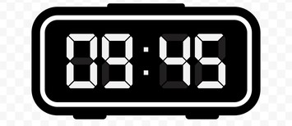
quarter to ten
ខ្វះ ១៥នាទី ម៉ោង១០

Slide 4

Listen and repeat
What time is it now?
តើពេលនេះម៉ោងប៉ុន្មាន?

Slide 5

Listen and repeat
Now is quarter to ten.
ពេលនេះគឺខ្វះ១៥នាទីម៉ោង១០

Slide 6
Pair work
What time is it now?
Now is quarter to ten.
11, 12, 1, 2, 3, 4, 5, 6, 7, 8, 9, 10……..

Slide 7






Let’s play game !!
11, 12, 1, 2, 3, 4, 5, 6, 7, 8, 9, 10……..
1
What time is it now?
Now is quarter to ………..
What time is it now?
Now is quarter to ten.
What time is it now?
4
2
Now is quarter to ………..
What time is it now?
3

Slide 8


Slide 9


By Hun chanseyha

