Slide 1



English grade 6
Chapter 4 My hometown
Unit 2 The way to my house
Where is the rat?
Student’s book 81

Slide 2
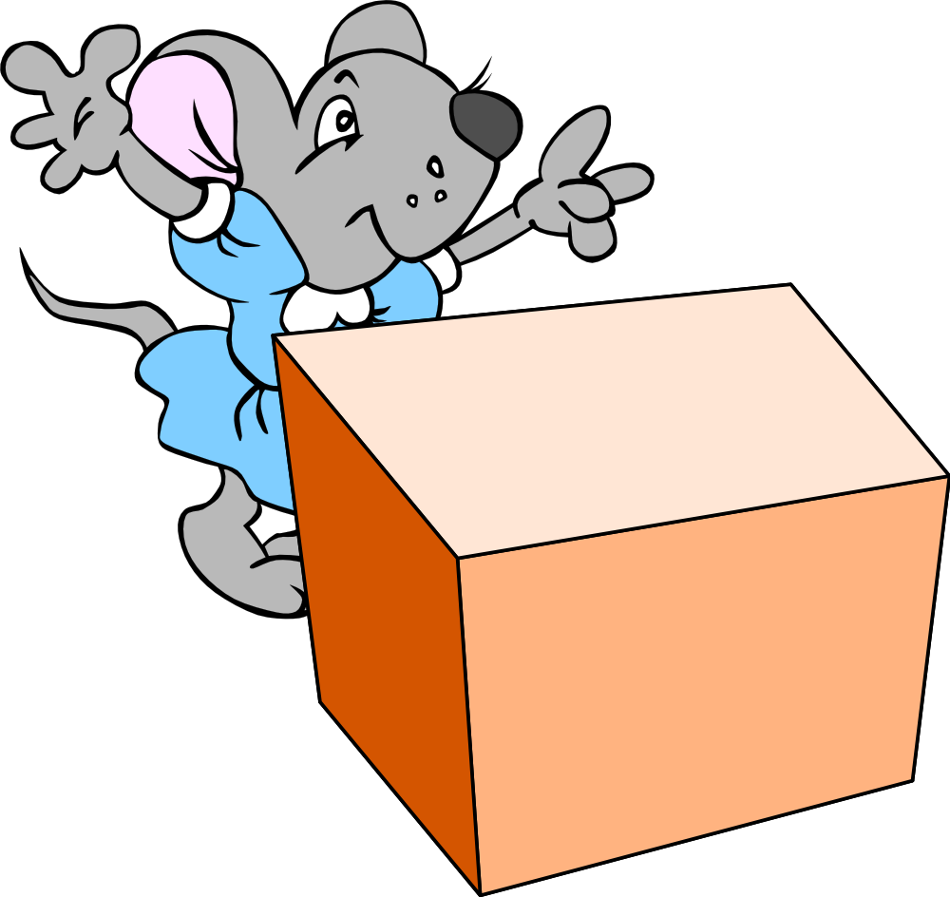
behind
នៅខាងក្រោយ

Slide 3
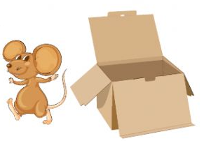
near
នៅជិត

Slide 4
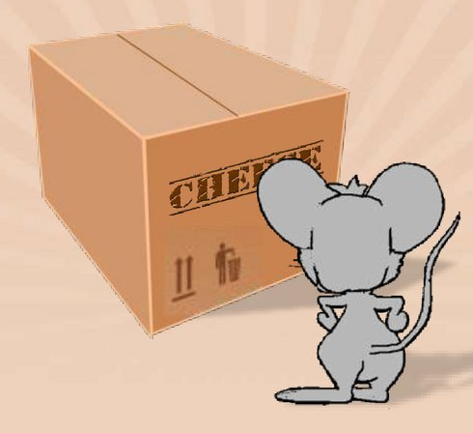
opposite
នៅទល់មុខ

Slide 5

Listen and repeat
Where is the rat?
តើកណ្ដុរនៅឯណា?

Slide 6

Listen and repeat
It is behind the box.
កណ្ដុរនៅខាងក្រោយប្រអប់

Slide 7
Pair work
Where is the rat?
It is behind the box.
Behind, near, opposite

Slide 8






Let’s play game !!
Behind, near, opposite
1
Where is the rat?
It is …………the box.
Where is the rat?
It is behind the box.
Where is the rat?
4
2
It is …………the box.
Where is the rat?
3

Slide 9


Slide 10


By Hun chanseyha

